Slide 1


What I’ve learned from teaching science in prison
Philip J. Heron
Marie Sklodowska Curie Fellow
Durham University

Slide 2
What I’ve learned from teaching science in prison
Philip J. Heron
Marie Sklodowska Curie Fellow
Durham University
Prof Danielle George (Manchester University), Dr Hannah King (Sociology, Durham University), Dr Paula Street (Durham Uni), Dr Lorraine Coghill (Durham University), Prof Andy Aplin (Durham University), Dr Mhairi Stewart (Cell Block Science, St Andrews), Dr Fiona Measham & Dr Kate O’Brien (Inside-Out Training Programme), British Geophysical Association, European Geosciences Union, European Union Horizon2020, Leila Cole & Rachael Matthews (Research Office), Dr Ivan Hill (Criminology, Durham University), The amazing Earth Science Finance team, Marianne Burrows & Sarah Blackman (HMP Low Newton), Lynda Elliott (HMP Durham), Cheryl Adamson (HMP/YOI Deerbolt), VC Stuart Corbridge (Durham University), Dr Adam Robinson (Durham University). Prof Jeroen van Hunen (Durham University), Prof Tony Key (University of Toronto), Dr Chris Saville (Durham University).

Slide 3
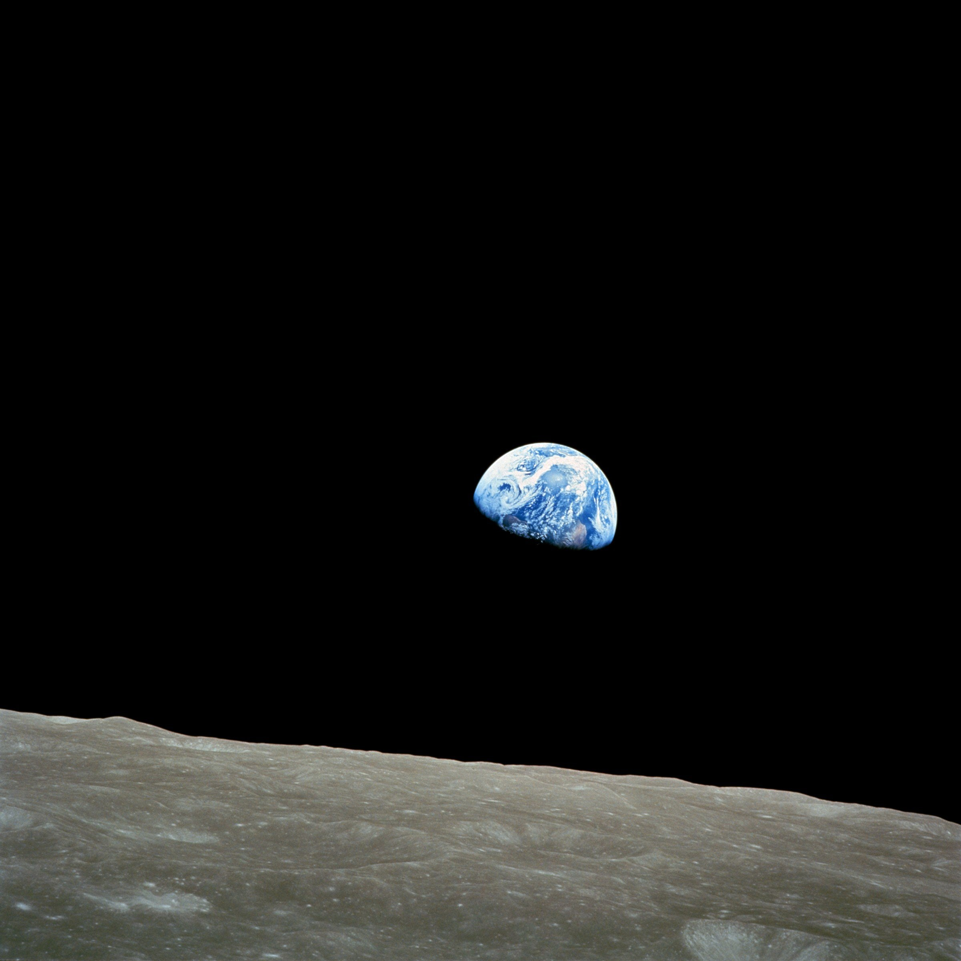
Think Like A Scientist
Course for people interested in science and nature
Once a week for 7 weeks (2.5 hour class)
Teaches how to think like a scientist
Understanding, Analysis, Communication
Pathway to education

Slide 4
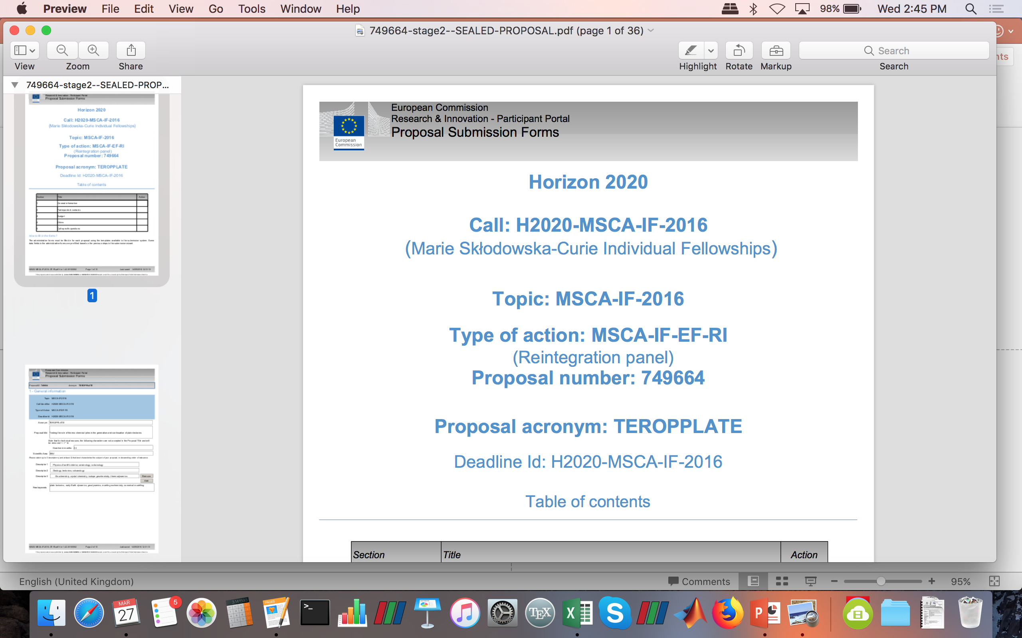
How?

Slide 5
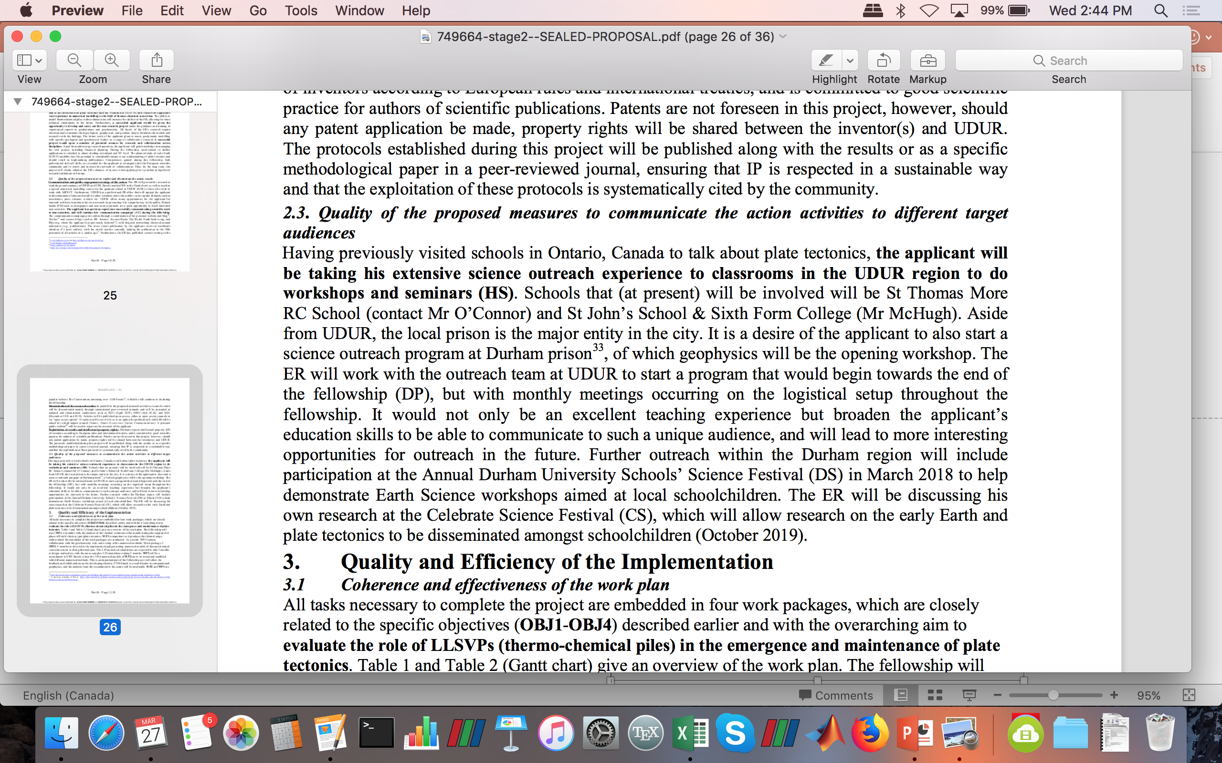
How?

Slide 6
How?

Slide 7


Previous courses
CELL BLOCK SCIENCE

Slide 8
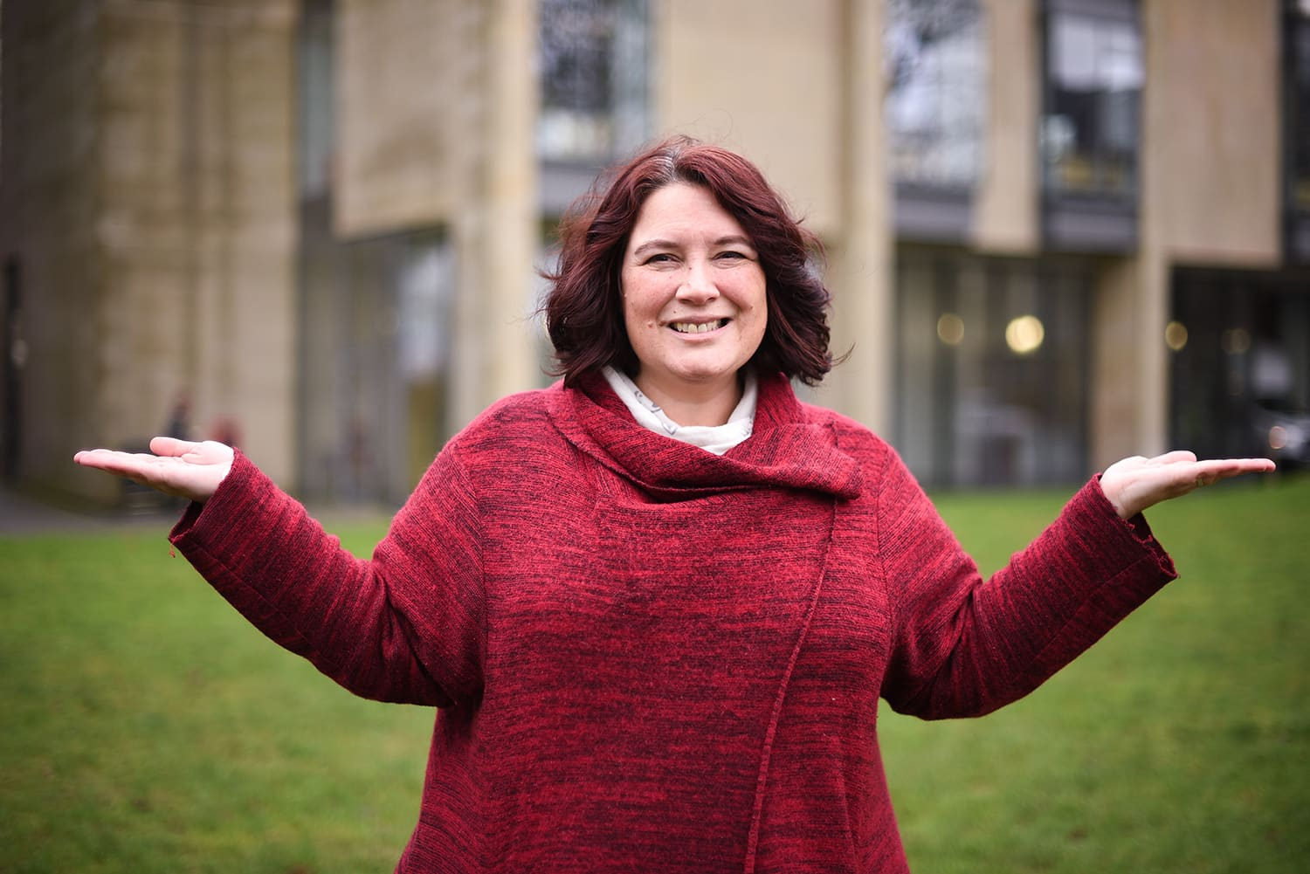
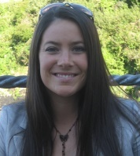
Previous courses
CELL BLOCK SCIENCE
Mhairi Stewart
Hannah King

Slide 9
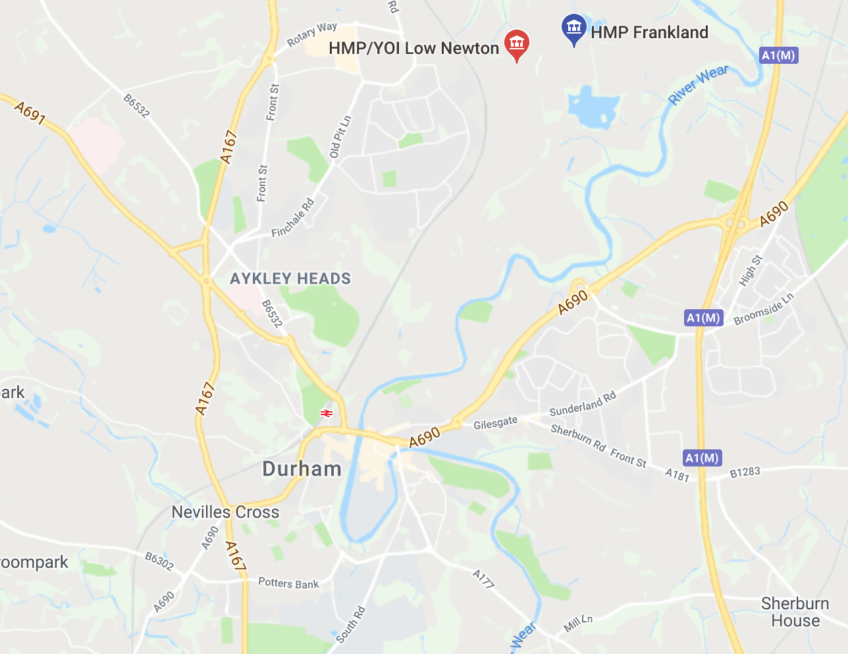
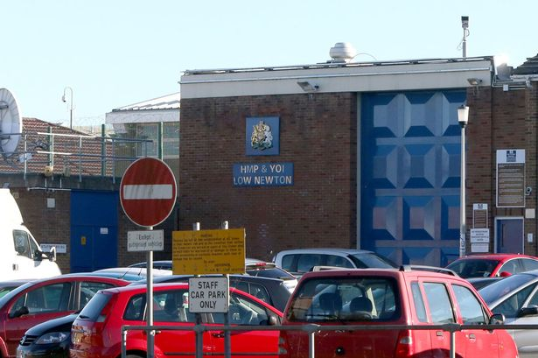
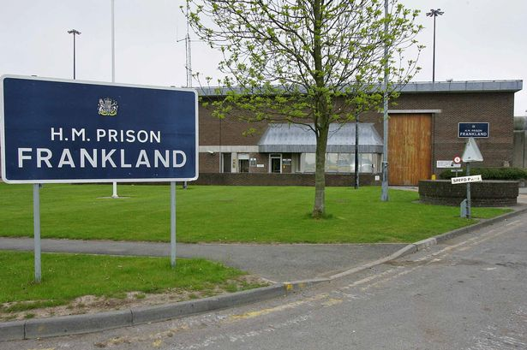
Input from inmates & others

Slide 10
Challenges
An important aspect of prison teaching is to ensure consistency each week – trust needs to be earned in the classroom
Inclusivity of all students is important at all times
The students will have varied educational abilities (accessible and engaging)
There will be no access to internet at any point

Slide 11

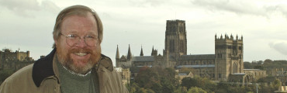
A Short History…

Slide 12
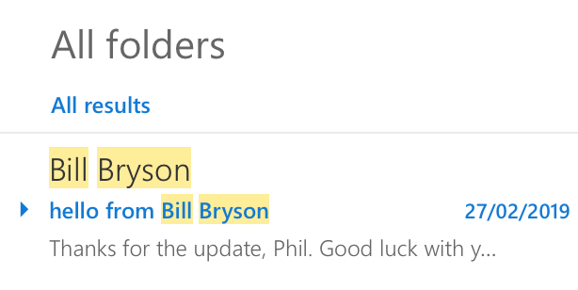
A Short History…

Slide 13
Outline
Week | Hot topic | Scientist | Assignment | Chapter
1 | Introduction and The Scientific Method | Richard Feynman
2 | CERN / Big Bang/ Higgs Boson | Stephen Hawking/Fabiola Gianotti | Formative assessment | 1/2/3
3 | Plate tectonics | Alfred Wegener/Mary Anning/William Smith |  | 6/12
4 | Radioactivity | Marie Sklodowska Curie |  | 7
5 | Relativity and Quantum theory | Albert Einstein/Brian Cox | Summative assessment 1 | 8/9
6 | Space Missions | Mars Mission team/Carl Sagan/Johannes Kepler |  | 10/11
7 | Guest Lecture | The Guest Lecture |  | TBD
8 | Climate change | James Hansen | Summative assessment 2 | 26
9 | Volcanoes | Rosaly Lopes/Christopher Jackson | Formative assessment 2 | 14
10 | End of class reflection

Slide 14
A Short History…

Slide 15
A Short History…

Slide 16
Challenges
An important aspect of prison teaching is to ensure consistency each week – trust needs to be earned in the classroom
Inclusivity of all students is important at all times
The students will have varied educational abilities (accessible and engaging)
There will be no access to internet at any point

Slide 17

Theme

Slide 18
Theme
Focus on different ways of thinking
Three pillars: Understanding, Analysis, Communication
Inclusive environment (dialogue?)
Confidence (having a voice)

Slide 19
The Scientific Method
The Scientific Method is a guide for conducting scientific research
Step 1: Posing a question?
LN2019 Think Like A Scientist W1

Slide 20
The Scientific Method
The Scientific Method is a guide for conducting scientific research
Step 1: Posing a question?
Step 2: Construct a hypothesis
Step 3: Conduct experiments
Step 4: Understanding
Step 5: Analysis
LN2019 Think Like A Scientist W1

Slide 21
The Scientific Method
The Scientific Method is a guide for conducting scientific research
Step 1: Posing a question?
Step 2: Construct a hypothesis
Step 3: Conduct experiments
Step 4: Understanding
Step 5: Analysis
Step 6: Communicate
LN2019 Think Like A Scientist W1

Slide 22
The Scientific Method
The Scientific Method is a guide for conducting scientific research
Step 1: Posing a question?
Step 2: Construct a hypothesis
Step 3: Conduct experiments
Step 4: Understanding
Step 5: Analysis
Step 6: Communicate
Does our research answer our question?
LN2019 Think Like A Scientist W1

Slide 23
The Scientific Method
The Scientific Method is a guide for conducting scientific research
Step 1: Posing a question?
Step 2: Construct a hypothesis
Step 3: Conduct experiments
Step 4: Understanding
Step 5: Analysis
Step 6: Communicate
No
Does our research answer our question?
LN2019 Think Like A Scientist W1

Slide 24
The Scientific Method
The Scientific Method is a guide for conducting scientific research
Step 1: Posing a question?
Step 2: Construct a hypothesis
Step 3: Conduct experiments
Step 4: Understanding
Step 5: Analysis
Step 6: Communicate
No
Does our research answer our question?
Yes
LN2019 Think Like A Scientist W1

Slide 25
The Scientific Method
The Scientific Method is a guide for conducting scientific research
Step 1: Posing a question?
Step 2: Construct a hypothesis
Step 3: Conduct experiments
Step 4: Understanding
Step 5: Analysis
Step 6: Communicate
No
Does our research answer our question?
LN2019 Think Like A Scientist W1

Slide 26
Plan
Week 1 (22/1/19): The Science of Sleep (health and wellbeing)
Week 2 (29/1/19): The Atmosphere (climate change, air quality)
Week 3 (5/2/19): Geoscience (earthquakes, volcanoes, plate tectonics)
Week 4 (12/2/19): Space Missions (Mars and beyond)
Week 5 (19/2/19): The Universe (what is left to discover)
Week 6 (26/2/19): *Guest Speaker*
Week 7 (5/3/19): Final presentations and round-up
Weekly setup:
Understanding: We’ll learn about a science topic each week.
Analysing: We’ll study an article and see what else we need to know.
Communicating: We will learn how to present ideas to others.
LN2019 Think Like A Scientist W1

Slide 27
Plan
Week 1 (22/1/19): The Science of Sleep (health and wellbeing)
Week 2 (29/1/19): The Atmosphere (climate change, air quality)
Week 3 (5/2/19): Geoscience (earthquakes, volcanoes, plate tectonics)
Week 4 (12/2/19): Space Missions (Mars and beyond)
Week 5 (19/2/19): The Universe (what is left to discover)
Week 6 (26/2/19): *Guest Speaker*
Week 7 (5/3/19): Final presentations and round-up
Weekly setup:
Understanding: We’ll learn about a science topic each week.
Analysing: We’ll study an article and see what else we need to know.
Communicating: We will learn how to present ideas to others.
LN2019 Think Like A Scientist W1

Slide 28
Plan
Week 1 (22/1/19): The Science of Sleep (health and wellbeing)
Week 2 (29/1/19): The Atmosphere (climate change, air quality)
Week 3 (5/2/19): Geoscience (earthquakes, volcanoes, plate tectonics)
Week 4 (12/2/19): Space Missions (Mars and beyond)
Week 5 (19/2/19): The Universe (what is left to discover)
Week 6 (26/2/19): *Guest Speaker*
Week 7 (5/3/19): Final presentations and round-up
Weekly setup:
Understanding: We’ll learn about a science topic each week.
Analysing: We’ll study an article and see what else we need to know.
Communicating: We will learn how to present ideas to others.
LN2019 Think Like A Scientist W1

Slide 29
Plan
Week 1 (22/1/19): The Science of Sleep (health and wellbeing)
Week 2 (29/1/19): The Atmosphere (climate change, air quality)
Week 3 (5/2/19): Geoscience (earthquakes, volcanoes, plate tectonics)
Week 4 (12/2/19): Space Missions (Mars and beyond)
Week 5 (19/2/19): The Universe (what is left to discover)
Week 6 (26/2/19): *Guest Speaker*
Week 7 (5/3/19): Final presentations and round-up
Weekly setup:
Understanding: We’ll learn about a science topic each week.
Analysing: We’ll study an article and see what else we need to know.
Communicating: We will learn how to present ideas to others.
LN2019 Think Like A Scientist W1

Slide 30
Plan
Week 1 (22/1/19): The Science of Sleep (health and wellbeing)
Week 2 (29/1/19): The Atmosphere (climate change, air quality)
Week 3 (5/2/19): Geoscience (earthquakes, volcanoes, plate tectonics)
Week 4 (12/2/19): Space Missions (Mars and beyond)
Week 5 (19/2/19): The Universe (what is left to discover)
Week 6 (26/2/19): *Guest Speaker*
Week 7 (5/3/19): Final presentations and round-up
Weekly setup:
Understanding: We’ll learn about a science topic each week.
Analysing: We’ll study an article and see what else we need to know.
Communicating: We will learn how to present ideas to others.
LN2019 Think Like A Scientist W1

Slide 31
Plan
Week 1 (22/1/19): The Science of Sleep (health and wellbeing)
Week 2 (29/1/19): The Atmosphere (climate change, air quality)
Week 3 (5/2/19): Geoscience (earthquakes, volcanoes, plate tectonics)
Week 4 (12/2/19): Space Missions (Mars and beyond)
Week 5 (19/2/19): The Universe (what is left to discover)
Week 6 (26/2/19): *Guest Speaker*
Week 7 (5/3/19): Final presentations and round-up
Weekly setup:
Understanding: We’ll learn about a science topic each week.
Analysing: We’ll study an article and see what else we need to know.
Communicating: We will learn how to present ideas to others.
LN2019 Think Like A Scientist W1

Slide 32
Plan
Week 1 (22/1/19): The Science of Sleep (health and wellbeing)
Week 2 (29/1/19): The Atmosphere (climate change, air quality)
Week 3 (5/2/19): Geoscience (earthquakes, volcanoes, plate tectonics)
Week 4 (12/2/19): Space Missions (Mars and beyond)
Week 5 (19/2/19): The Universe (what is left to discover)
Week 6 (26/2/19): *Guest Speaker*
Week 7 (5/3/19): Final presentations and round-up
Weekly setup:
Understanding: We’ll learn about a science topic each week.
Analysing: We’ll study an article and see what else we need to know.
Communicating: We will learn how to present ideas to others.
LN2019 Think Like A Scientist W1

Slide 33
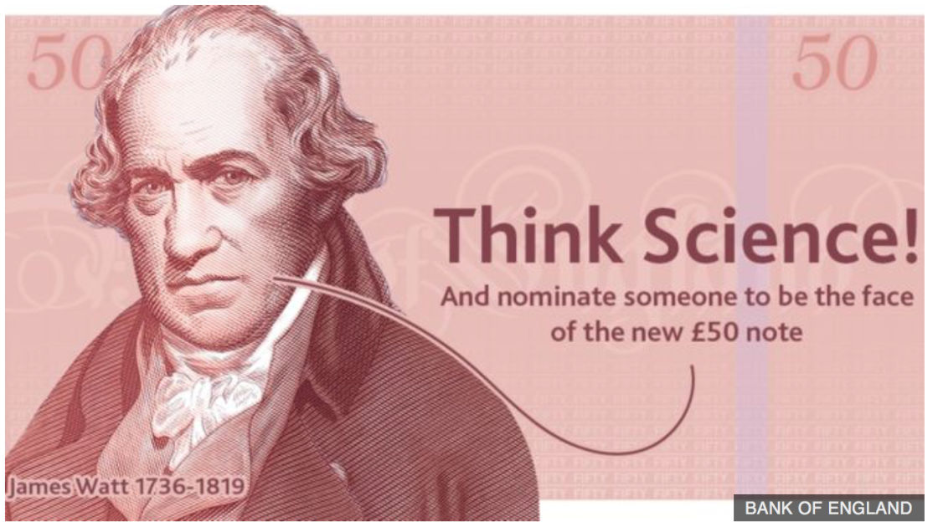
Final Presentations
Currently, the Bank of England is looking for nominations of British scientists to be the face of the new £50 note.
LN2019 Think Like A Scientist W1

Slide 34
First course – HMP Low Newton

Slide 35
Prohibited items
Mobile phones / Cameras / Video cameras / Recording devices;
Cigarettes / Tobacco;
Drugs, syringes or any other drug paraphernalia;
Weapons (guns, knives etc.);
Chemicals / Flammable liquids / Explosives;
Medication: over the counter, prescribed or herbal;
Alcohol and alcohol based products;
Electronic games consoles, MP3 players, iPods, electronic storage devices including USB flashdrives, memory sticks;
Multi-media items, CDs, DVDs, films, videos, prohibited publications;
Electronic items, including rechargeable toothbrushes, razors, clippers etc.;
Lighters, matches, candles, incense, aerosol-pressure spray can;
Metal cutlery / glass bottles or glass containers, non-transparent lunch boxes;
Colours / patches / gang identification and associated clothing;
Handkerchiefs;
Tattooing materials, tools, weights, magnet / magnetic devices.

Slide 36
Prohibited items
Mobile phones / Cameras / Video cameras / Recording devices;
Cigarettes / Tobacco;
Drugs, syringes or any other drug paraphernalia;
Weapons (guns, knives etc.);
Chemicals / Flammable liquids / Explosives;
Medication: over the counter, prescribed or herbal;
Alcohol and alcohol based products;
Electronic games consoles, MP3 players, iPods, electronic storage devices including USB flashdrives, memory sticks;
Multi-media items, CDs, DVDs, films, videos, prohibited publications;
Electronic items, including rechargeable toothbrushes, razors, clippers etc.;
Lighters, matches, candles, incense, aerosol-pressure spray can;
Metal cutlery / glass bottles or glass containers, non-transparent lunch boxes;
Colours / patches / gang identification and associated clothing;
Handkerchiefs;
Tattooing materials, tools, weights, magnet / magnetic devices.
NO SCIENCE EXPERIMENTS

Slide 37
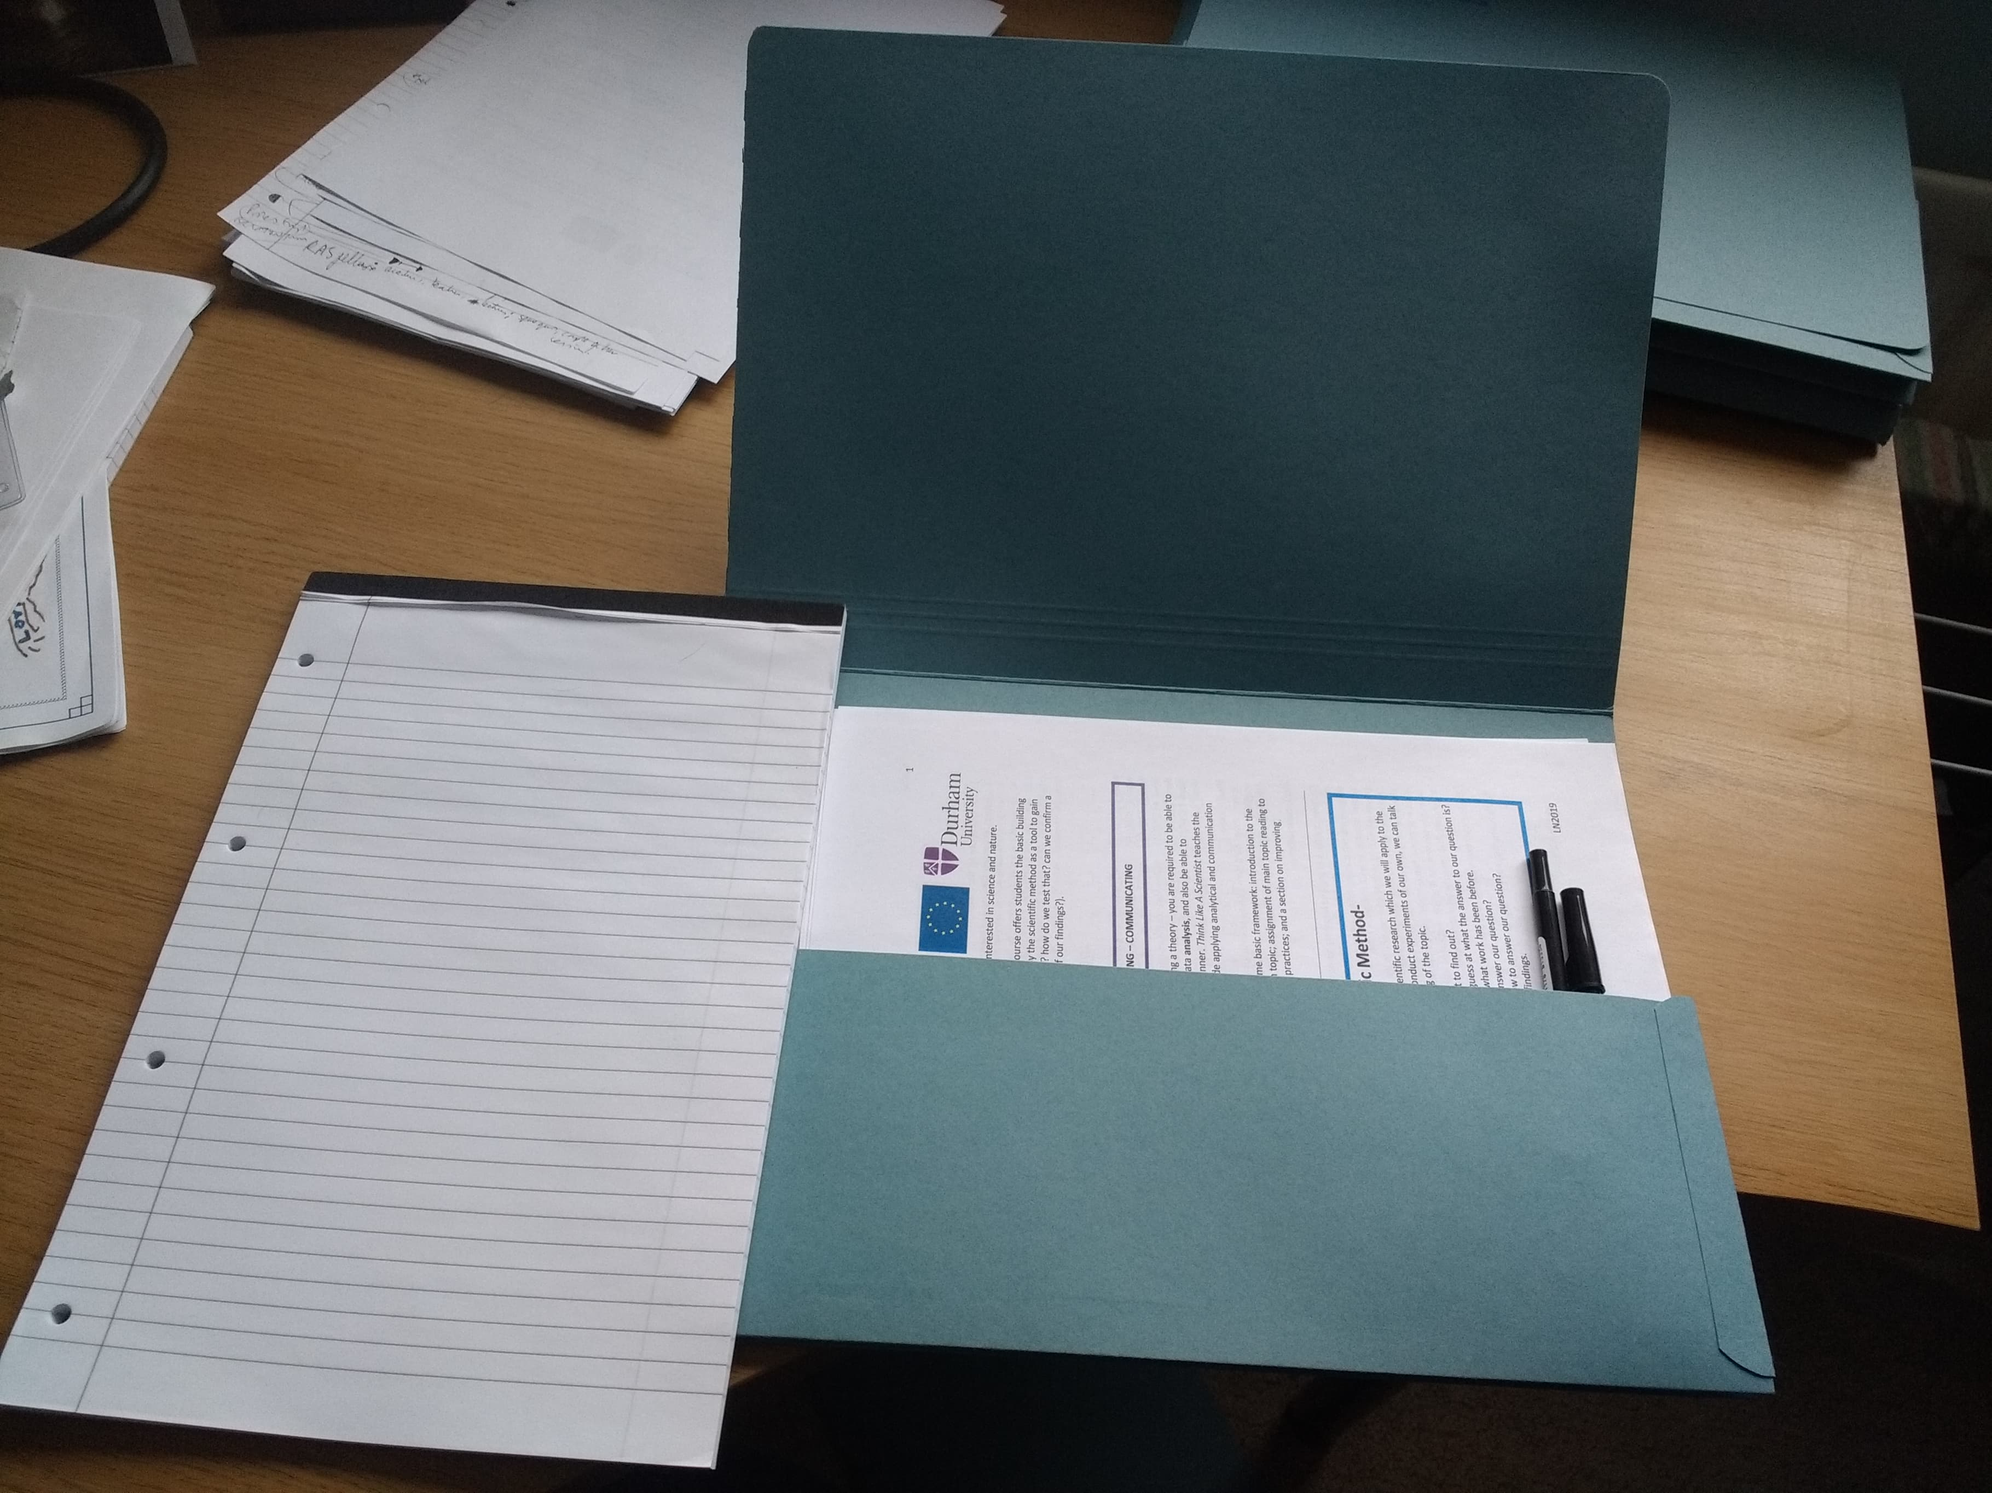
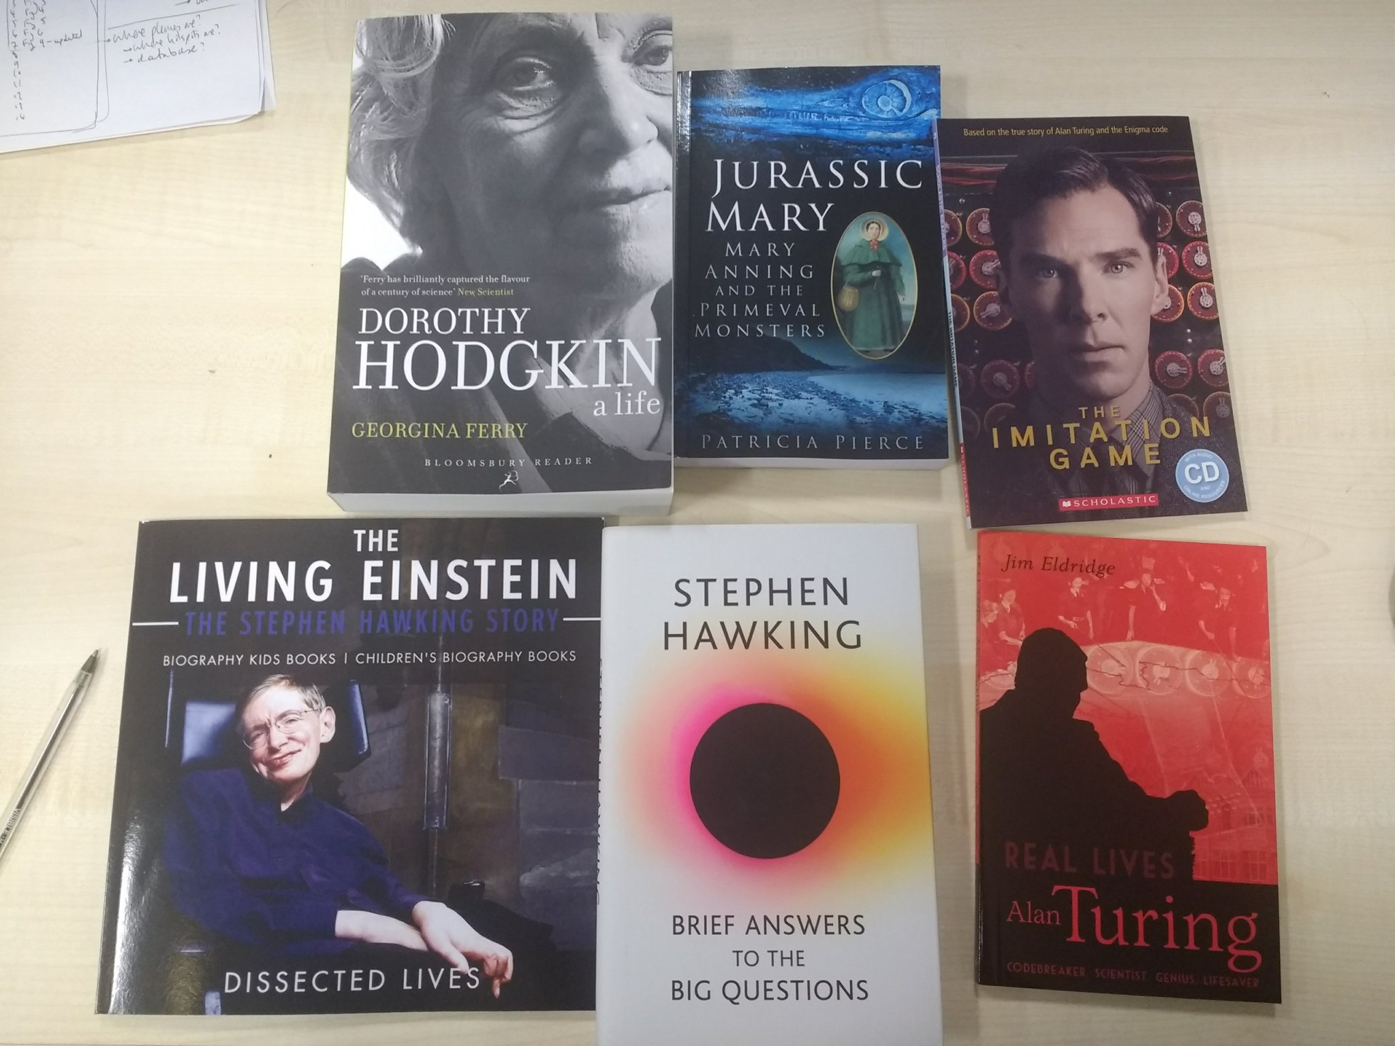
Course Pack
Books
LN2019 Think Like A Scientist W1

Slide 38
Plan
Week 1 (22/1/19): The Science of Sleep (health and wellbeing)
Week 2 (29/1/19): The Atmosphere (climate change, air quality)
Week 3 (5/2/19): Geoscience (earthquakes, volcanoes, plate tectonics)
Week 4 (12/2/19): Space Missions (Mars and beyond)
Week 5 (19/2/19): The Universe (what is left to discover)
Week 6 (26/2/19): *Guest Speaker*
Week 7 (5/3/19): Final presentations and round-up
Weekly setup:
Understanding: We’ll learn about a science topic each week.
Analysing: We’ll study an article and see what else we need to know.
Communicating: We will learn how to present ideas to others.
LN2019 Think Like A Scientist W1

Slide 39
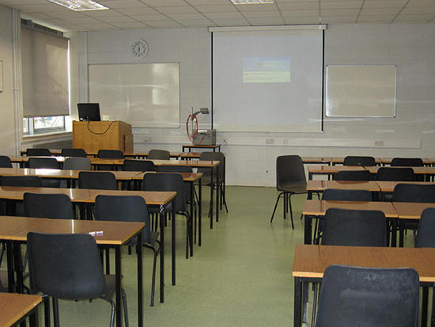
Classroom setting

Slide 40
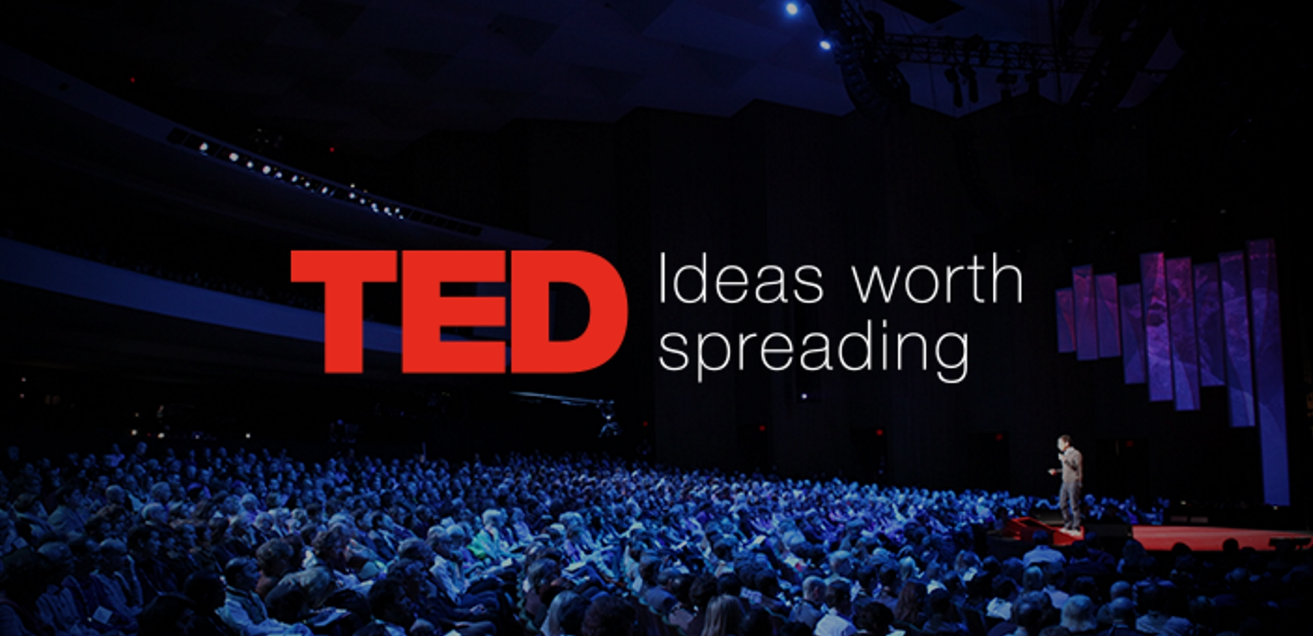
Learning style

Slide 41
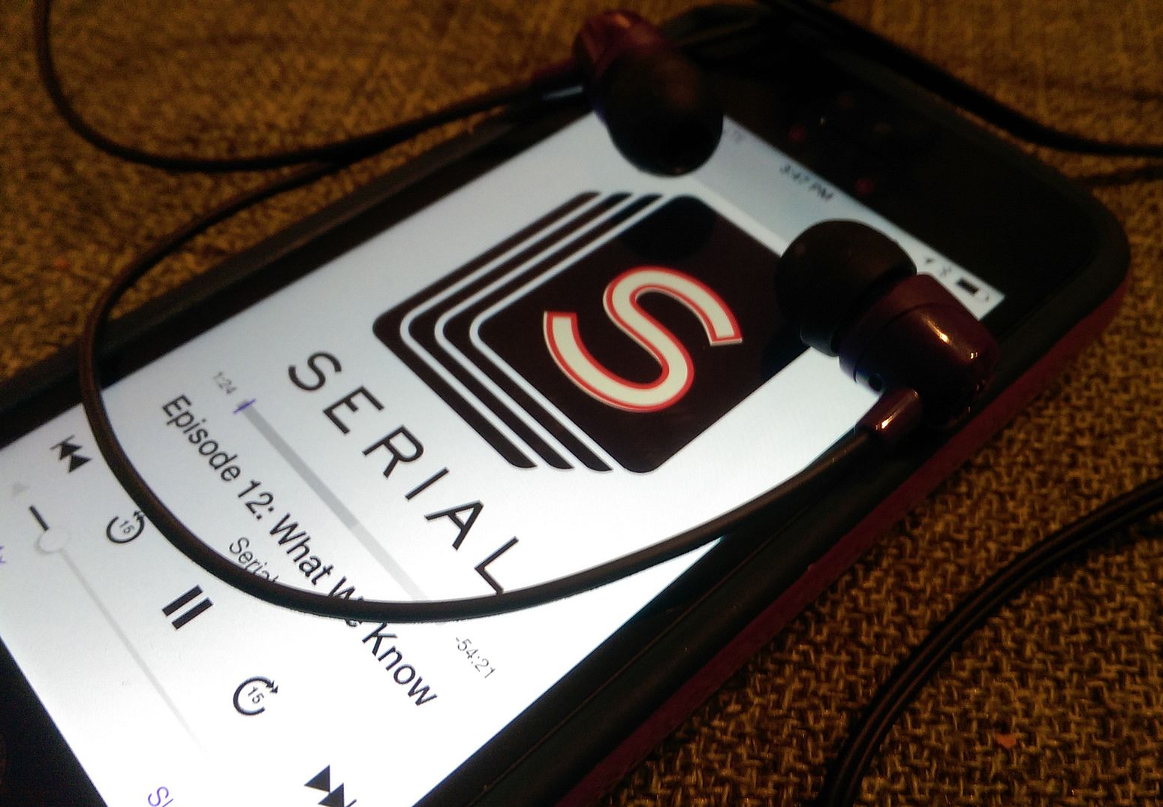

Learning style

Slide 42
Learning style
[ACCESSIBILE]
[ENGAGING]
[NARRATIVE]

Slide 43

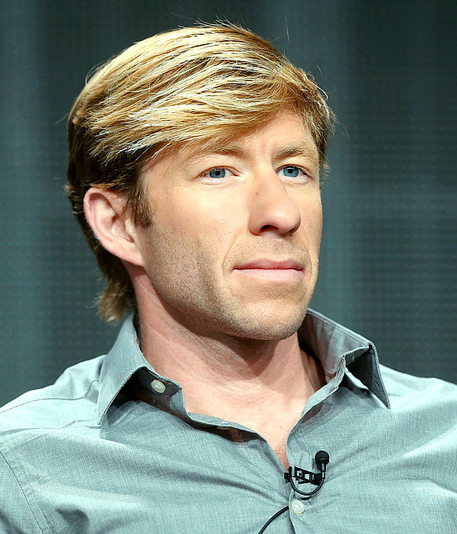
The Science of Sleep
Dr Matthew Walker
Professor of Neuroscience and Psychology at the University of California, Berkeley, USA.
Source: Getty images
LN2019 Think Like A Scientist W1

Slide 44
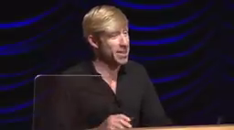
Multi-media learning material
Dr Matthew Walker
Professor of Neuroscience and Psychology at the University of California, Berkeley, USA.
[ACCESSIBILE]
[ENGAGING]
[NARRATIVE]

Slide 45

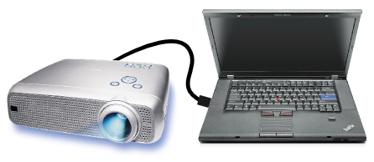
Setup

Slide 46
Setup

Slide 47
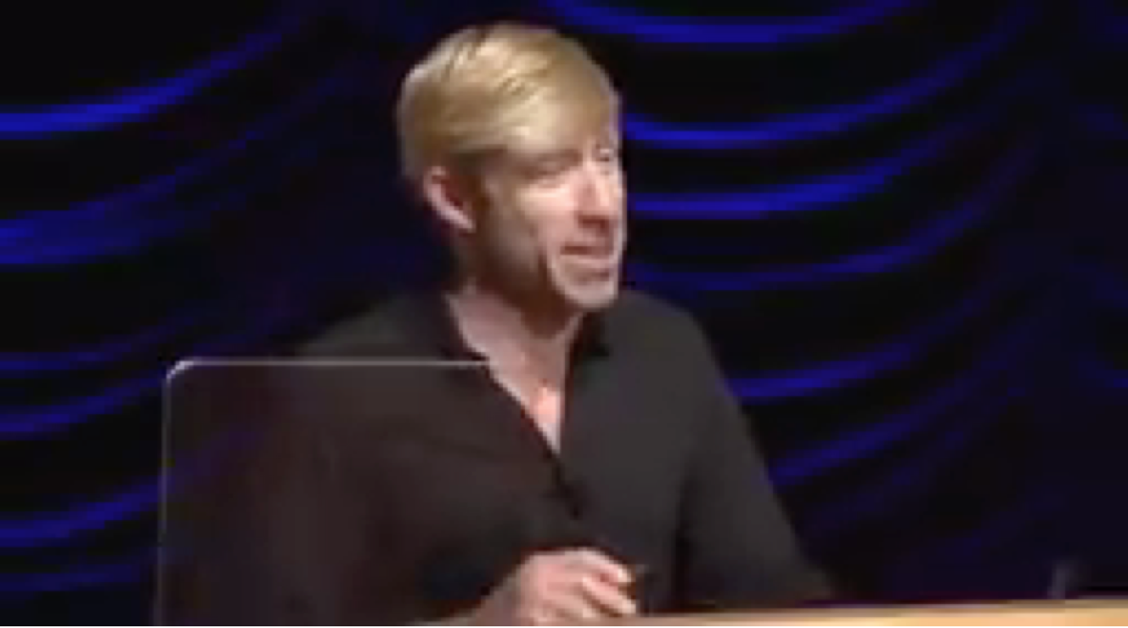
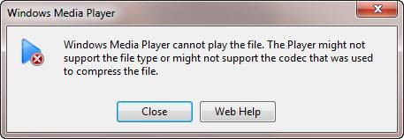
Setup
PLAY

Slide 48
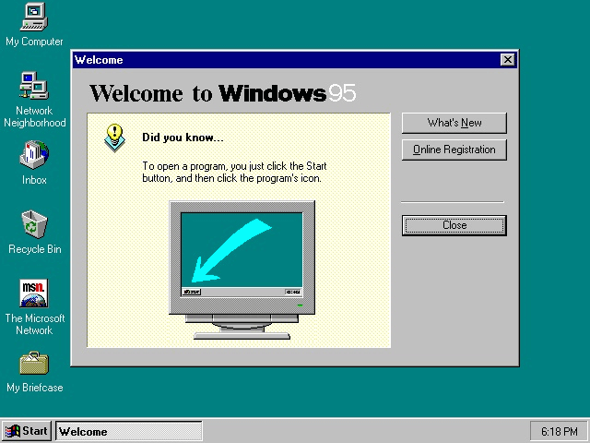
Setup

Slide 49
Setup
PLAY

Slide 50
Setup
PLAY

Slide 51
Setup
PLAY

Slide 52
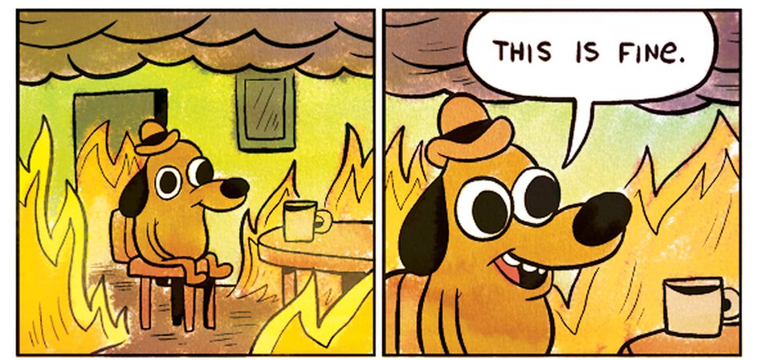
Setup
PLAY

Slide 53

Restrictive Teaching Environment

Slide 54

Restrictive Teaching Environment

Slide 55
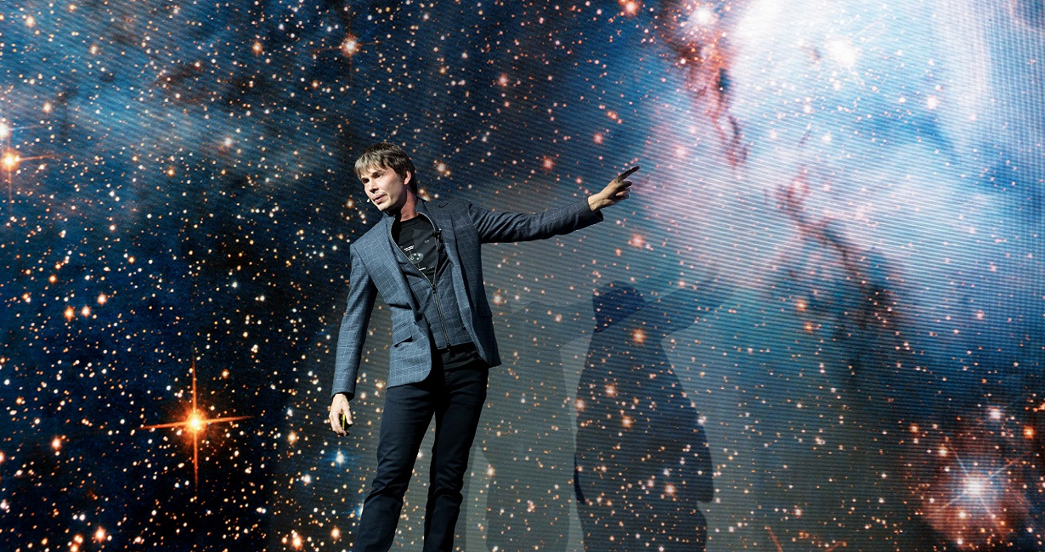
Expectation vs Reality

Slide 56
Expectation vs Reality

Slide 57
Planning classes
Time | Activity
Arrive at 8:00 am
8:45 – 9:00 am
9:00 – 9:15 am
9:15 – 9:30 am
9:30 – 9:45 am
9:45 – 10:00 am
10:00 – 10:15 am
10:15 – 10:30 am
10:30 – 10:45 am
10:45 – 11:00 am
11:00 – 11:15 am
Leave at 11:30 am

Slide 58
Planning classes
Time | Activity
Arrive at 8:00 am
8:45 – 9:00 am | Discussion of previous week
9:00 – 9:15 am
9:15 – 9:30 am
9:30 – 9:45 am
9:45 – 10:00 am
10:00 – 10:15 am | Coffee break
10:15 – 10:30 am
10:30 – 10:45 am
10:45 – 11:00 am
11:00 – 11:15 am | Wrap up & homework description
Leave at 11:30 am

Slide 59
Planning classes
Time | Activity
Arrive at 8:00 am
8:45 – 9:00 am | Discussion of previous week
9:00 – 9:15 am | What is sleep?
9:15 – 9:30 am
9:30 – 9:45 am
9:45 – 10:00 am
10:00 – 10:15 am | Coffee break
10:15 – 10:30 am
10:30 – 10:45 am
10:45 – 11:00 am
11:00 – 11:15 am | Wrap up & homework description
Leave at 11:30 am

Slide 60
Planning classes
Time | Activity
Arrive at 8:00 am
8:45 – 9:00 am | Discussion of previous week
9:00 – 9:15 am | What is sleep?
9:15 – 9:30 am | Topic 1
9:30 – 9:45 am | Discussion
9:45 – 10:00 am | Topic 2
10:00 – 10:15 am | Coffee break
10:15 – 10:30 am | Topic 3
10:30 – 10:45 am | Discussion
10:45 – 11:00 am | Topic 4
11:00 – 11:15 am | Wrap up & homework description
Leave at 11:30 am

Slide 61
Understanding
[ACCESSIBILE]
[ENGAGING]
[NARRATIVE]

Slide 62

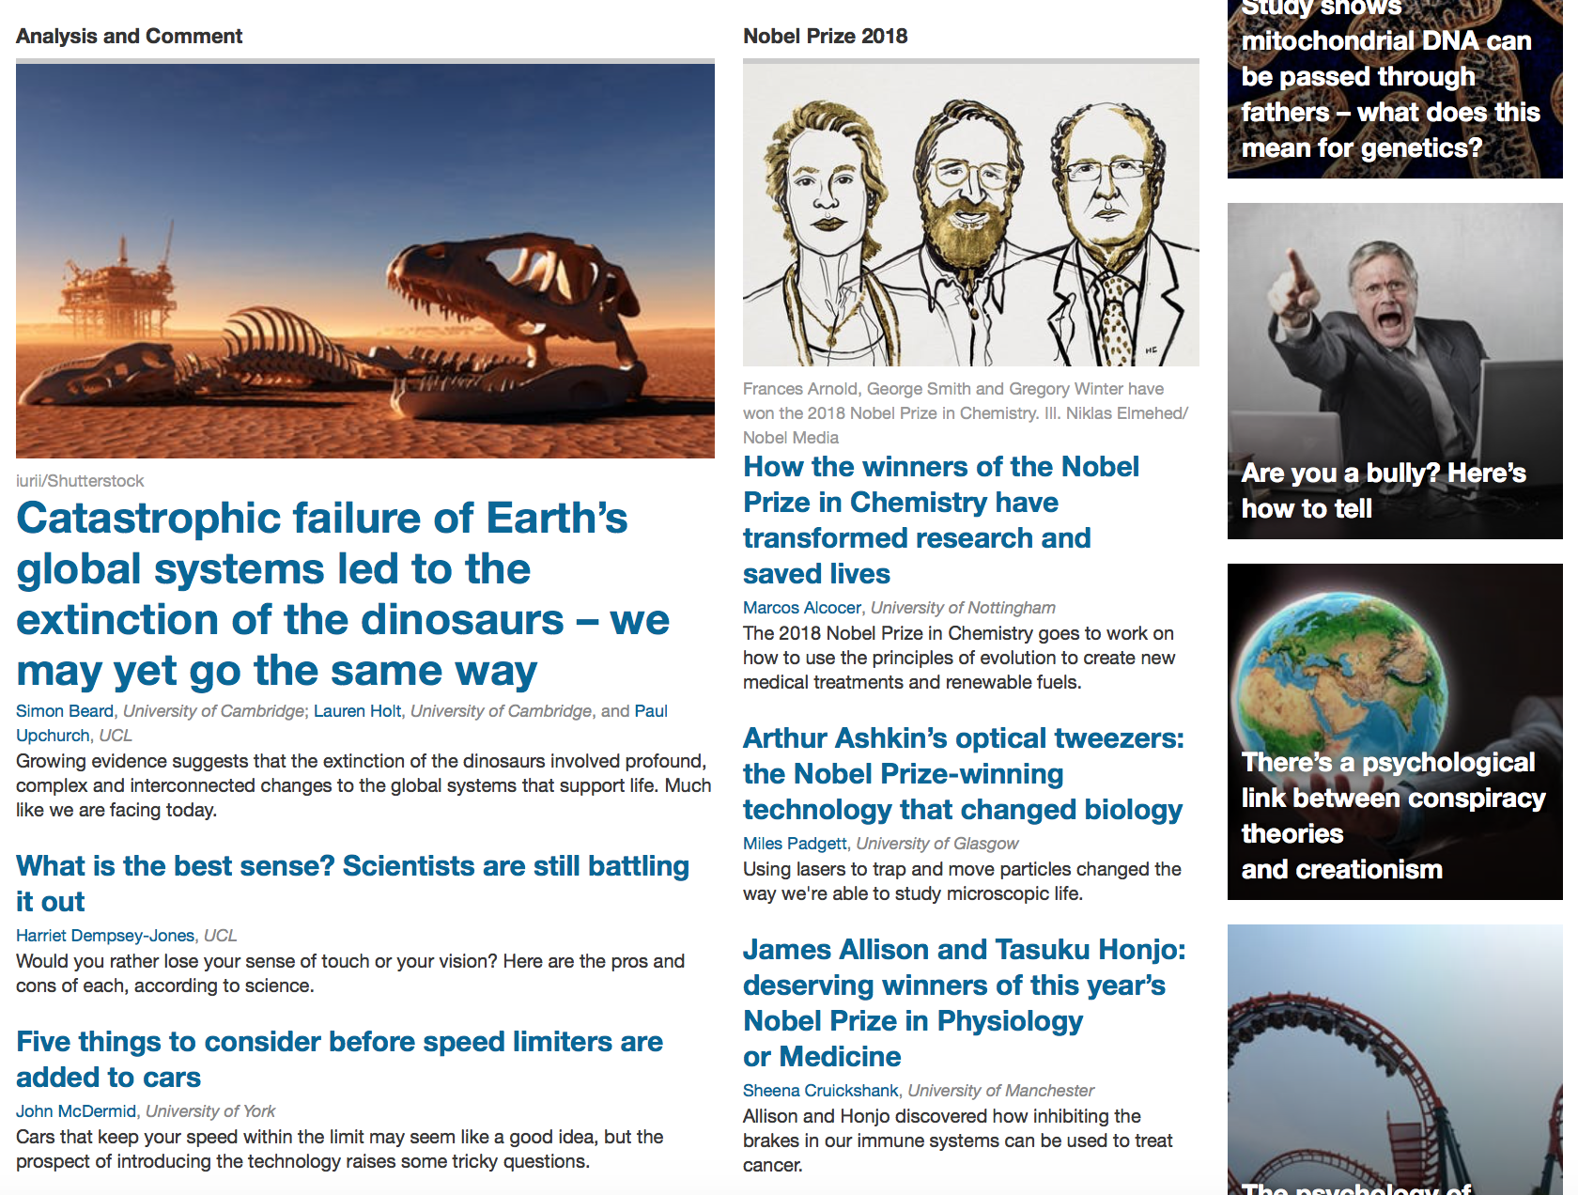
Analysis

Slide 63
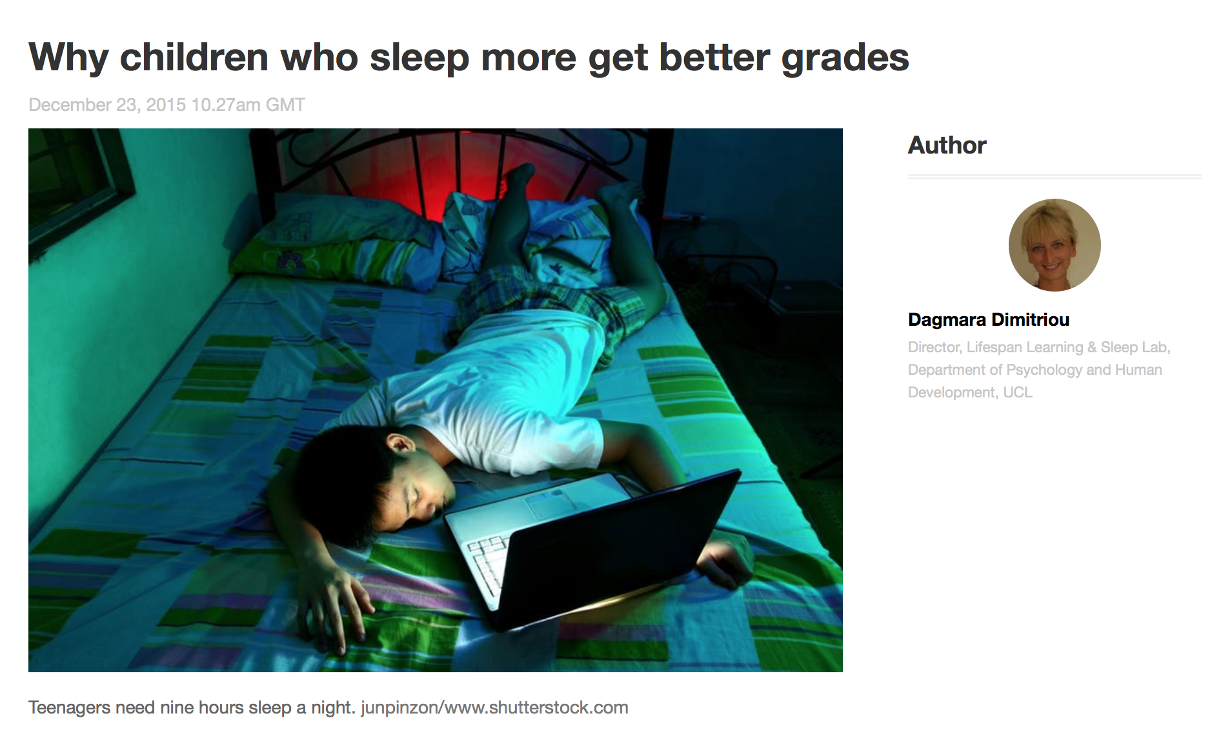
Analysis

Slide 64
Analysis
A framework for this assignment would be to write about the following:
What was the question the reading was asking?
What did you originally think about it?
What did they do to study the question?
What did they find out?
Is this surprising?
What are they missing?
Are you sceptical? What are you sceptical of?
What didn’t you understand?
What questions would you ask?
What else would you like to know?
How do you think we could find this out?
There is a two-side maximum on these assignments – ask questions, don’t be afraid to give opinions and ideas. Be bold.

Slide 65
Communicate

Slide 66
Plan
Week 1 (22/1/19): The Science of Sleep (health and wellbeing)
Week 2 (29/1/19): The Atmosphere (climate change, air quality)
Week 3 (5/2/19): Geoscience (earthquakes, volcanoes, plate tectonics)
Week 4 (12/2/19): Space Missions (Mars and beyond)
Week 5 (19/2/19): The Universe (what is left to discover)
Week 6 (26/2/19): *Guest Speaker*
Week 7 (5/3/19): Final presentations and round-up
Weekly setup:
Understanding: We’ll learn about a science topic each week.
Analysing: We’ll study an article and see what else we need to know.
Communicating: We will learn how to present ideas to others.
LN2019 Think Like A Scientist W1

Slide 67
Geoscience
Time | Activity
Arrive at 8:00 am
8:45 – 9:00 am | Recap on climate
9:00 – 9:15 am | What do we know about the Earth?
9:15 – 9:30 am | Earth interior and plate tectonics*
9:30 – 9:45 am | Supercontinents* and fossils
9:45 – 10:00 am | Types of volcanoes
10:00 – 10:15 am | Coffee break
10:15 – 10:30 am | Case studies: volcanoes
10:30 – 10:45 am | Earthquakes*
10:45 – 11:00 am | Case studies: earthquakes
11:00 – 11:15 am | Wrap up & homework description
Leave at 11:30 am

Slide 68
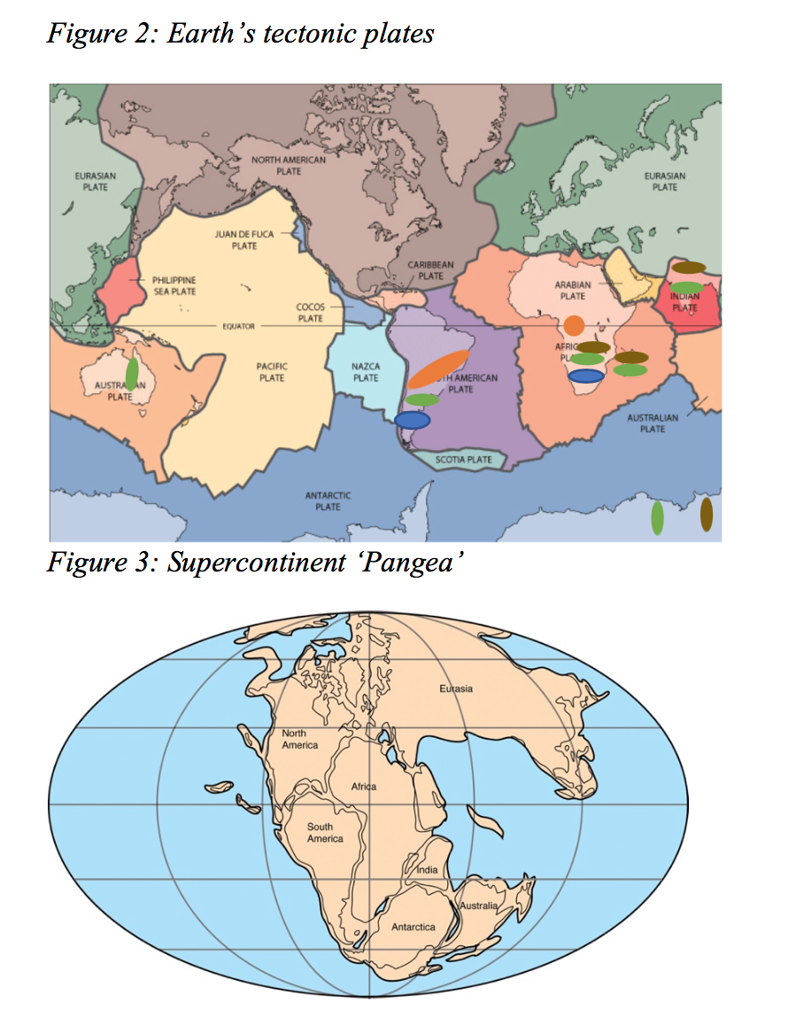
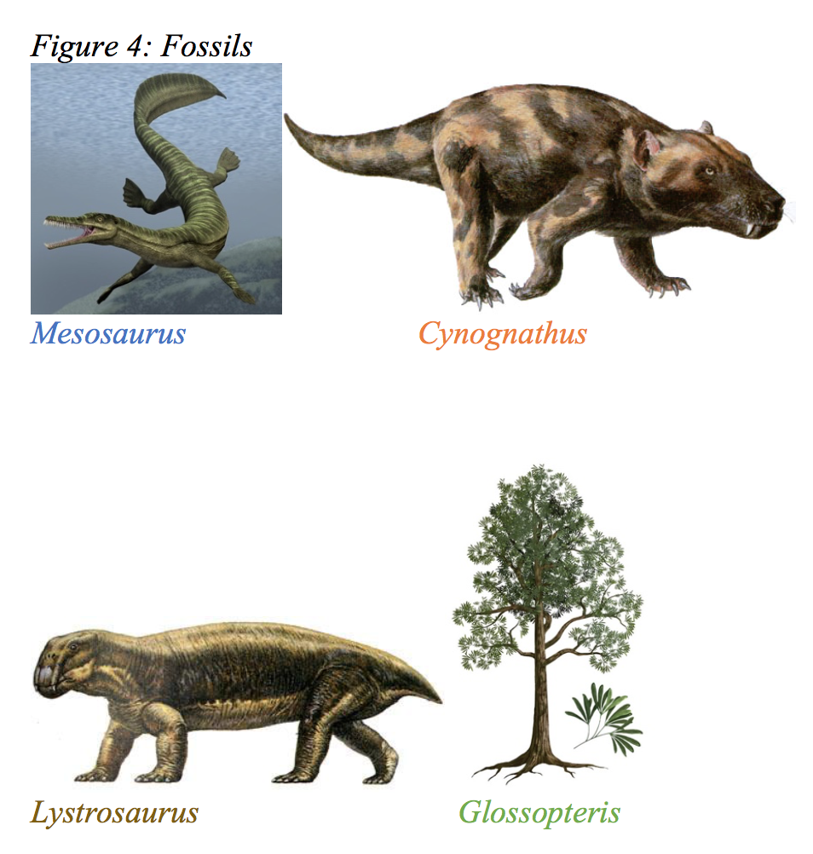
Geoscience

Slide 69
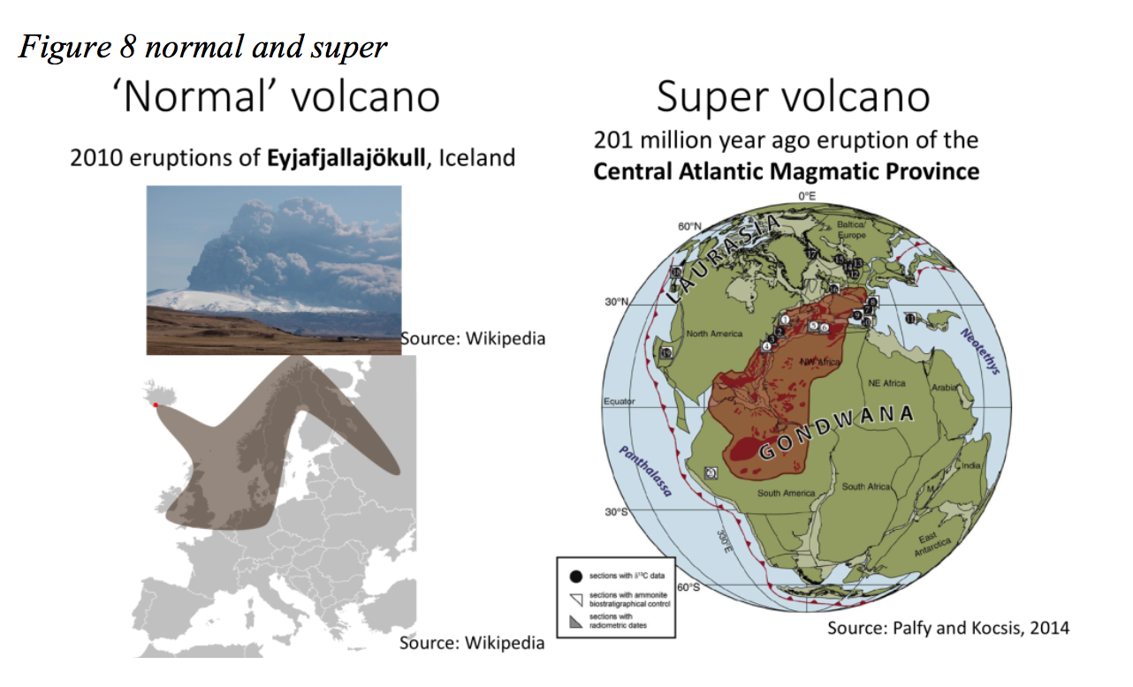
Geoscience

Slide 70
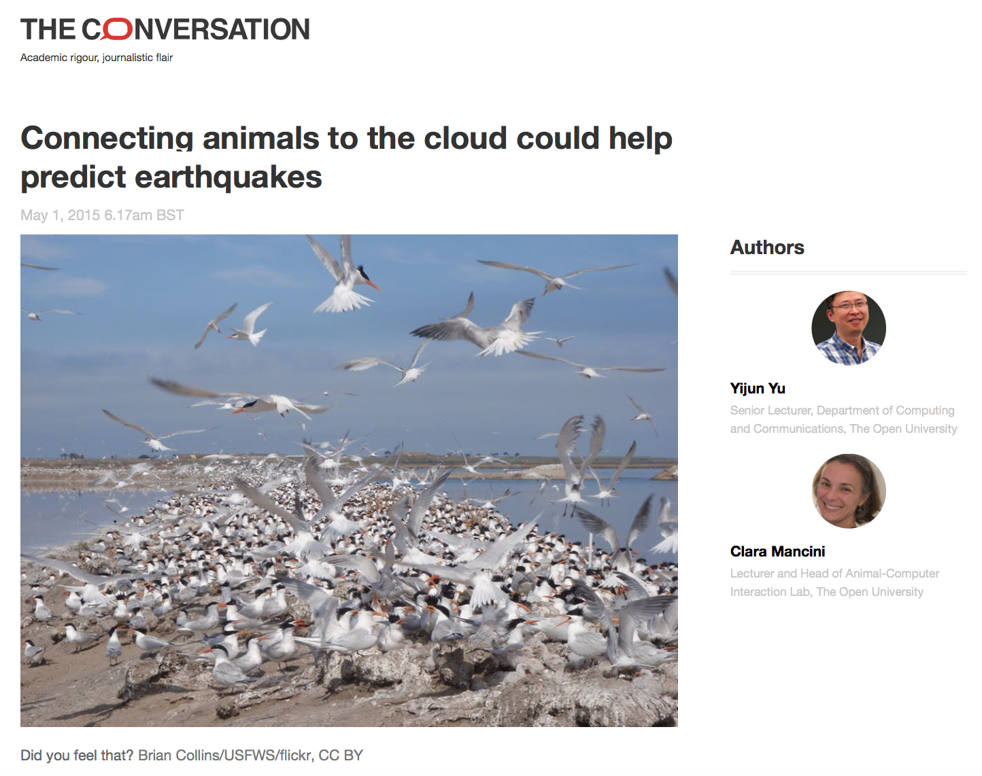
Homework
A framework for this assignment would be to write about the following:
What was the question the reading was asking?
What did you originally think about it?
What did they do to study the question?
What did they find out?
Is this surprising?
What are they missing?
Are you sceptical? What are you sceptical of?
What didn’t you understand?
What questions would you ask?
What else would you like to know?
How do you think we could find this out?
There is a two-side maximum on these assignments – ask questions, don’t be afraid to give opinions and ideas. Be bold.

Slide 71
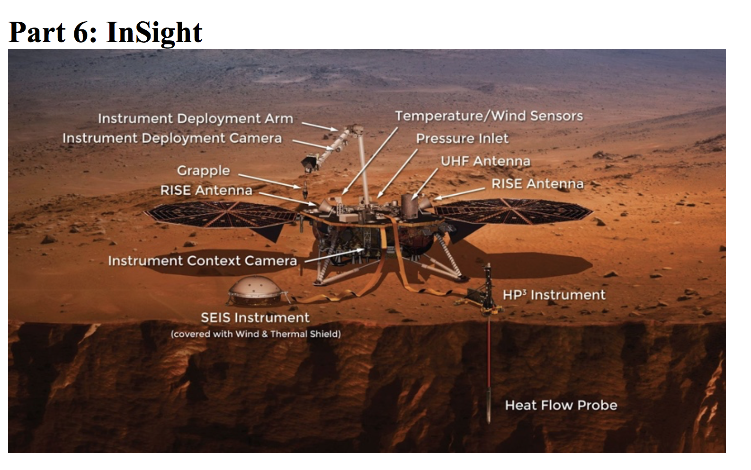
Homework

Slide 72
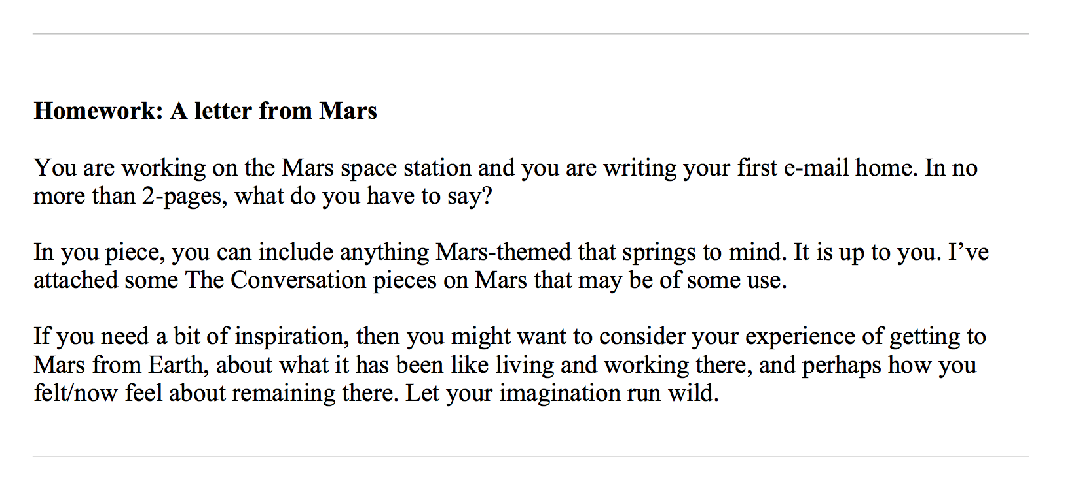
Homework

Slide 73
Homework
Hi Mum, this is my first message from the surface of Mars!
We landed early this morning and set foot on the planet in time to see the sun rise over our new home. The day has been busy, setting up the habitat and ensuring there were no leaks was our priority. It should be pressurized by the morning then the moving over of all the gear and supplies can be completed.
I was grateful that the gravity here is just one third of the Earth’s as some of the loads were quite large and surprisingly heavy. It is strange to have weight again after 9 months of weightlessness. The surface is very dry and the boots of our EVA suits kick up quite a lot of dust. I can see that being a problem for the airlock filters.
The starts here don’t twinkle as they do on Earth, this is due to the thin atmosphere. There are two moons in the sky and I am looking forward to pointing our telescope towards them tomorrow.

Slide 74
Experiment
Mobile phones / Cameras / Video cameras / Recording devices;
Cigarettes / Tobacco;
Drugs, syringes or any other drug paraphernalia;
Weapons (guns, knives etc.);
Chemicals / Flammable liquids / Explosives;
Medication: over the counter, prescribed or herbal;
Alcohol and alcohol based products;
Electronic games consoles, MP3 players, iPods, electronic storage devices including USB flashdrives, memory sticks;
Multi-media items, CDs, DVDs, films, videos, prohibited publications;
Electronic items, including rechargeable toothbrushes, razors, clippers etc.;
Lighters, matches, candles, incense, aerosol-pressure spray can;
Metal cutlery / glass bottles or glass containers, non-transparent lunch boxes;
Colours / patches / gang identification and associated clothing;
Handkerchiefs;
Tattooing materials, tools, weights, magnet / magnetic devices.
NO SCIENCE EXPERIMENTS

Slide 75
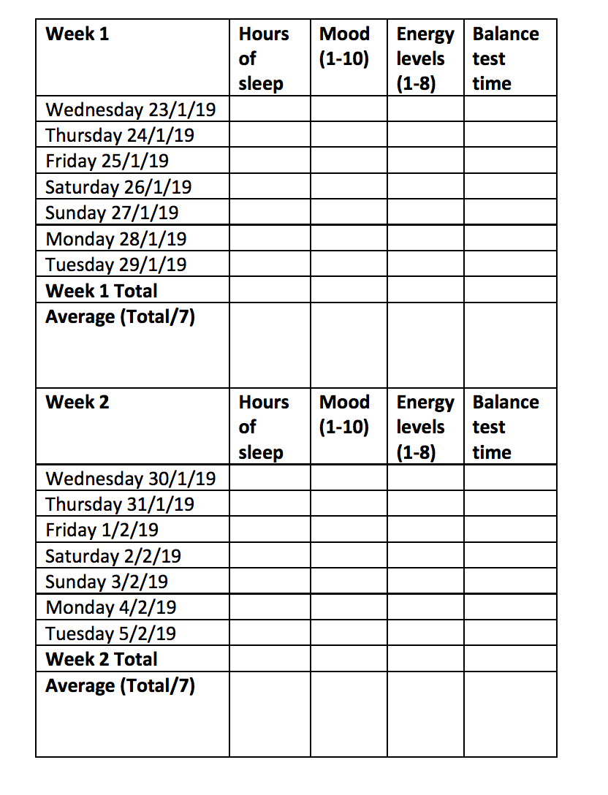
Experiment

Slide 76
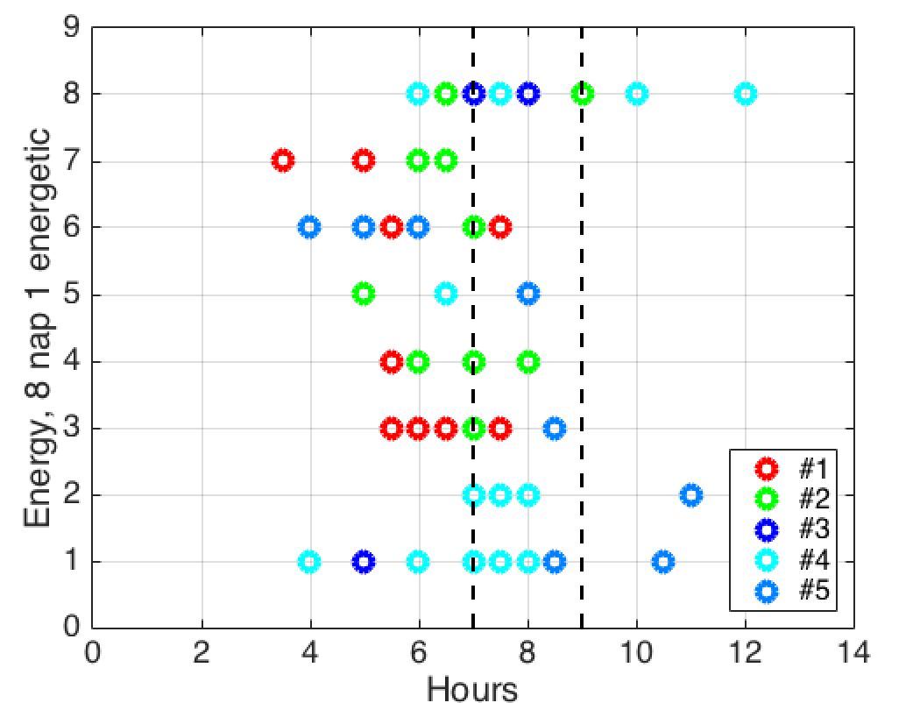
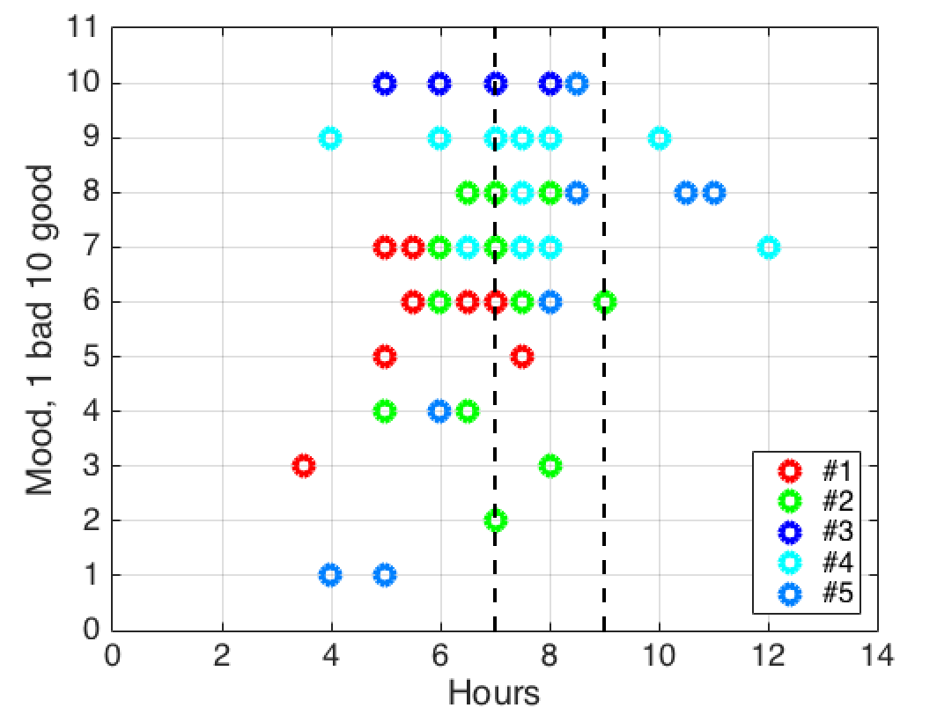
Experiment
Figure 7: Hours slept against energy levels
Figure 8: Hours slept against mood levels

Slide 77
Experiment
A framework for this assignment would be to write about the following:
What was the question the reading was asking?
What did you originally think about it?
What did they do to study the question?
What did they find out?
Is this surprising?
What are they missing?
Are you sceptical? What are you sceptical of?
What didn’t you understand?
What questions would you ask?
What else would you like to know?
How do you think we could find this out?
There is a two-side maximum on these assignments – ask questions, don’t be afraid to give opinions and ideas. Be bold.
Figure 7: Hours slept against energy levels
Figure 8: Hours slept against mood levels

Slide 78
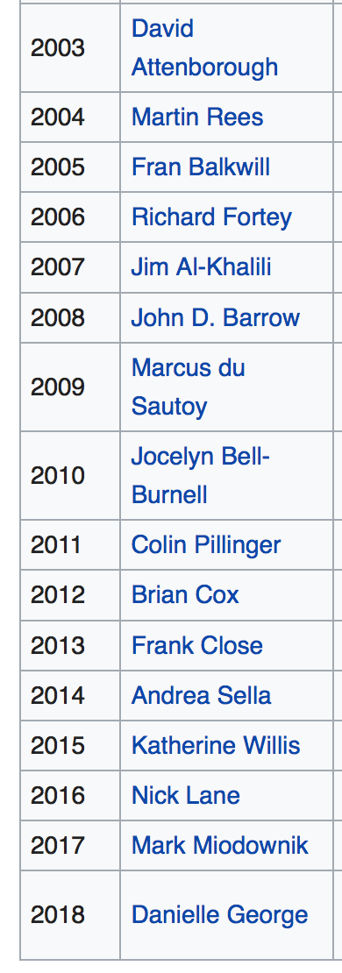
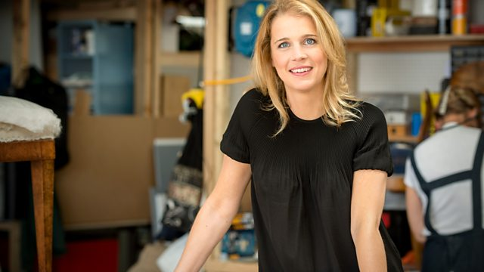
Guest Speaker
Danielle George
Professor Danielle George MBE was awarded the 2018 Michael Faraday Prize for her public outreach, promotion of her discipline, and leadership of national programmes inspiring young people to express their creativity while innovating in science and engineering.

Slide 79
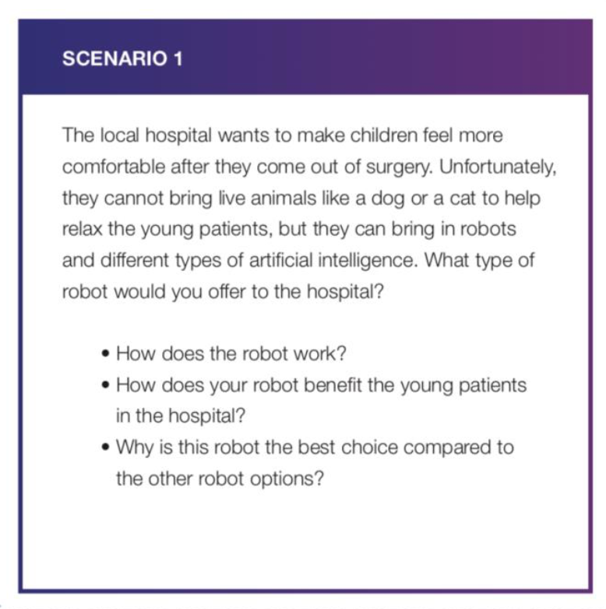
Guest Speaker
Danielle George
Professor Danielle George MBE was awarded the 2018 Michael Faraday Prize for her public outreach, promotion of her discipline, and leadership of national programmes inspiring young people to express their creativity while innovating in science and engineering.

Slide 80
Presentations
Currently, the Bank of England is looking for nominations of British scientists to be the face of the new £50 note.

Slide 81
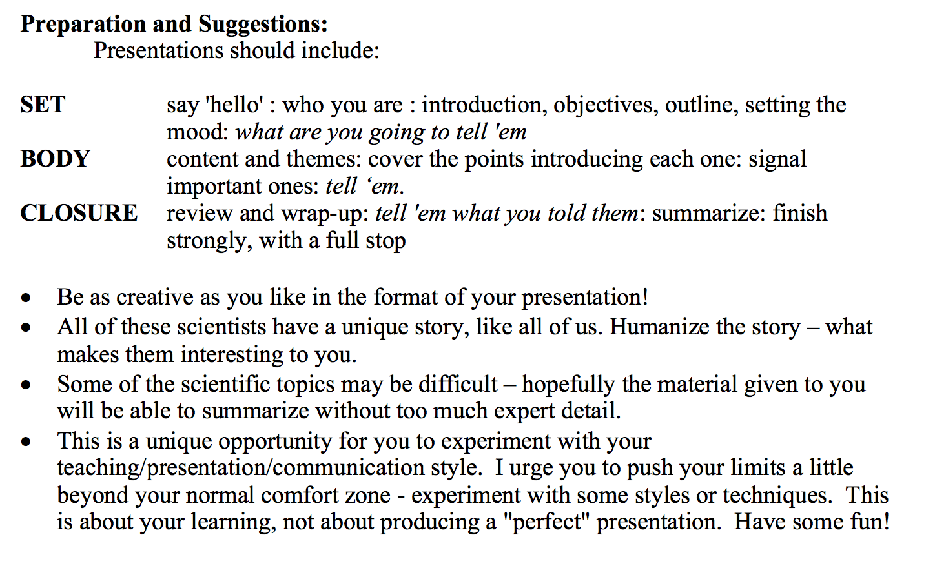
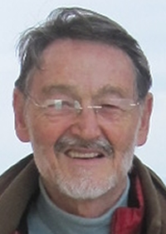
Presentations
Tony Key

Slide 82
Presentations

Slide 83
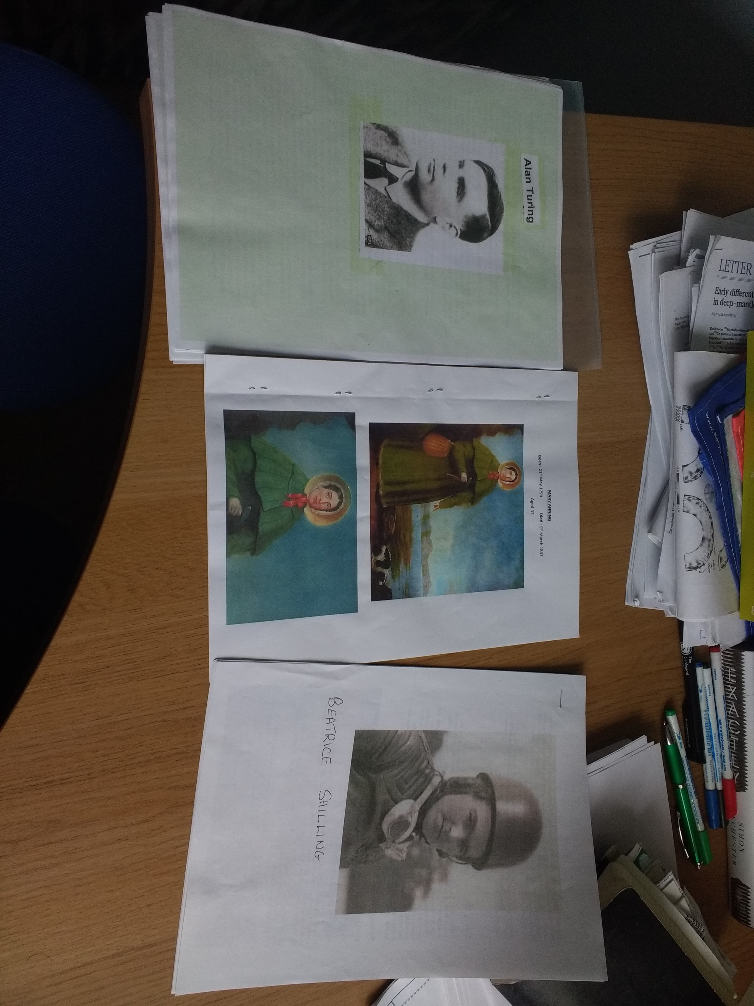
Presentations
Mary Anning

Slide 84
Presentations
Mary Anning Beatrice Shilling

Slide 85
Presentations
Mary Anning Beatrice Shilling Stephen Hawking

Slide 86
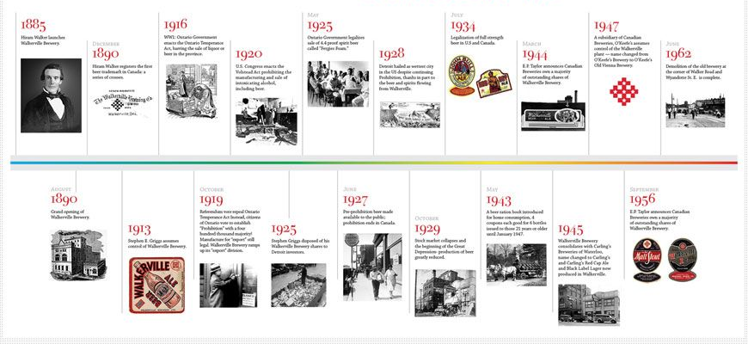
Presentations
Mary Anning Beatrice Shilling Stephen Hawking James Clerk Maxwell

Slide 87
Presentations
Mary Anning Beatrice Shilling Stephen Hawking James Clerk Maxwell Alan Turing

Slide 88
Students

Slide 89


THINK LIKE A SCIENTIST
“I am gaining a sense of confidence academically I never thought I had in me… that I do have a view and ideas and a thirst for knowledge - this course has ignited that.”
Student, HMP Low Newton
philheron.com/thinklikeascientist

Slide 90
Assessment
No formal assessment
Feedback on homework
Highlighting strong points
Discussion around points that were brought up
(not correcting for grammar or punctuation)

Slide 91
Prison Education
Difficult place to work and teach
Slooooooowwwwwwwwwwww
It is a restrictive teaching environment
Students have complex needs
Each prison is different
Why do we want to teach?

Slide 92
Impact factor
Funding agencies demand that we are impactful with our science
Can we be more useful?
Should we expand our portfolio of outreach away from classrooms and science fairs?
What are we trying to teach?

Slide 93
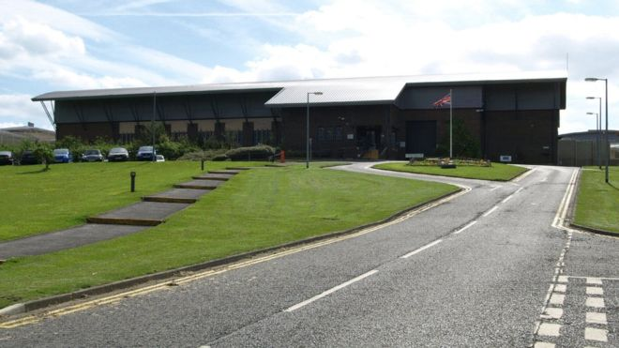
Future plans – Phase 2
April - May 2019
HMP Frankland
June - July 2019
HMP/YOI Deerbolt

Slide 94
Future plans – Phase 2
April - May 2019
TBD
HMP Frankland
June - July 2019
HMP/YOI Deerbolt

Slide 95
Future plans – Phase 2
April - May 2019
TBD
HMP Frankland
Pathways to education
Improving employability
Links to STEM employers
Rehabilitation through science education
June - July 2019
HMP/YOI Deerbolt

Slide 96






Future plans – longer term

Slide 97
What I’ve learned
Listen
Backup for backups
Detach from ideas
Be bold
Be present
Be honest
Trust is reciprocal
What do you want students to learn?
Anywhere

Slide 98
What I’ve learned
Listen
Backup for backups
Detach from ideas
Be bold
Be present
Be honest
Trust is reciprocal
What do you want students to learn?
Anywhere

Slide 99
What I’ve learned
Listen
Backup for backups
Detach from ideas
Be bold
Be present
Be honest
Trust is reciprocal
What do you want students to learn?
Anywhere

Slide 100
What I’ve learned
Listen
Backup for backups
Detach from ideas
Be bold
Be present
Be honest
Trust is reciprocal
What do you want students to learn?
Anywhere

Slide 101
What I’ve learned
Listen
Backup for backups
Detach from ideas
Be bold
Be present
Be honest
Trust is reciprocal
What do you want students to learn?
Anywhere

Slide 102
What I’ve learned
Listen
Backup for backups
Detach from ideas
Be bold
Be present
Be honest
Trust is reciprocal
What do you want students to learn?
Anywhere

Slide 103
What I’ve learned
Listen
Backup for backups
Detach from ideas
Be bold
Be present
Be honest
Trust is reciprocal
What do you want students to learn?
Anywhere

Slide 104
What I’ve learned
Listen
Backup for backups
Detach from ideas
Be bold
Be present
Be honest
Trust is reciprocal
What do you want students to learn?
Anywhere

Slide 105
What I’ve learned
Listen
Backup for backups
Detach from ideas
Be bold
Be present
Be honest
Trust is reciprocal
What do you want students to learn?
We can teach anywhere

Slide 106
What I’ve learned from teaching science in prison
Philip J. Heron
Prof Danielle George (Manchester University), Dr Hannah King (Sociology, Durham University), Dr Paula Street (Durham Uni), Dr Lorraine Coghill (Durham University), Prof Andy Aplin (Durham University), Dr Mhairi Stewart (Cell Block Science, St Andrews), Dr Fiona Measham & Dr Kate O’Brien (Inside-Out Training Programme), British Geophysical Association, European Geosciences Union, European Union Horizon2020, Leila Cole & Rachael Matthews (Research Office), Dr Ivan Hill (Criminology, Durham University), The amazing Earth Science Finance team, Marianne Burrows & Sarah Blackman (HMP Low Newton), Lynda Elliott (HMP Durham), Cheryl Adamson (HMP/YOI Deerbolt), VC Stuart Corbridge (Durham University), Dr Adam Robinson (Durham University). Prof Jeroen van Hunen (Durham University), Prof Tony Key (University of Toronto), Dr Chris Saville (Durham University).

Slide 107
Homework examples
Write up

Slide 108
THINK LIKE A SCIENTIST
“The course has given me more confidence and made me understand and see the world and universe around me in a different light”
Student, HMP Low Newton
philheron.com/thinklikeascientist

Slide 109
THINK LIKE A SCIENTIST
“I never got to go to college or university the way I planned when I was younger - this gave me a tick on the bucket list and for a few hours I felt like I lived a dream”
Student, HMP Low Newton
philheron.com/thinklikeascientist

Slide 110
THINK LIKE A SCIENTIST
“My mind feels like it has expanded, and I no longer feel like that stupid kid that never holds their hand up and holds their breath when the teacher asks a question”
Student, HMP Low Newton
philheron.com/thinklikeascientist

Slide 111
THINK LIKE A SCIENTIST
“The feedback I received each week was like receiving a prize - I've never felt like this and it means so much to me.”
Student, HMP Low Newton
philheron.com/thinklikeascientist

Slide 112
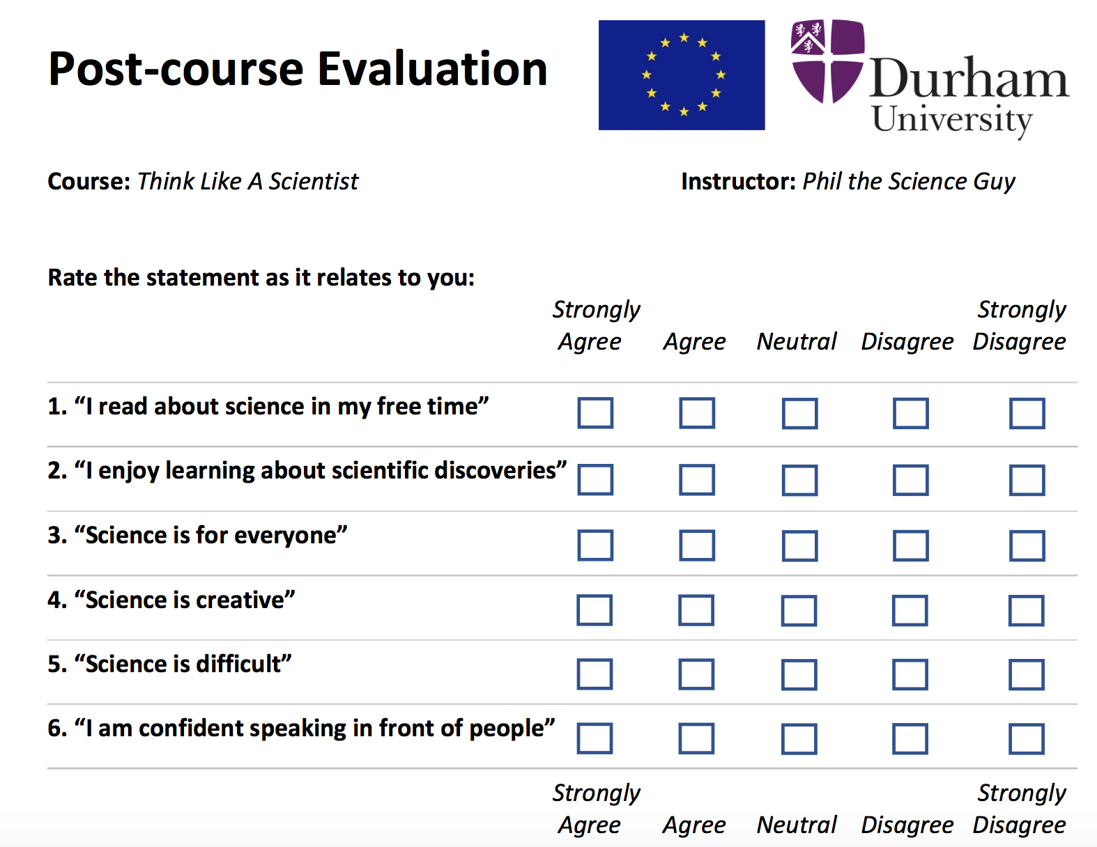
Questionnaires
Pre-course:
- Why do you want to take this course?
- What are your expectations?
- What is the best way to learn new things?
Post-course:
- What was the best part of the course?
- Did the course help you in any way?

Slide 113
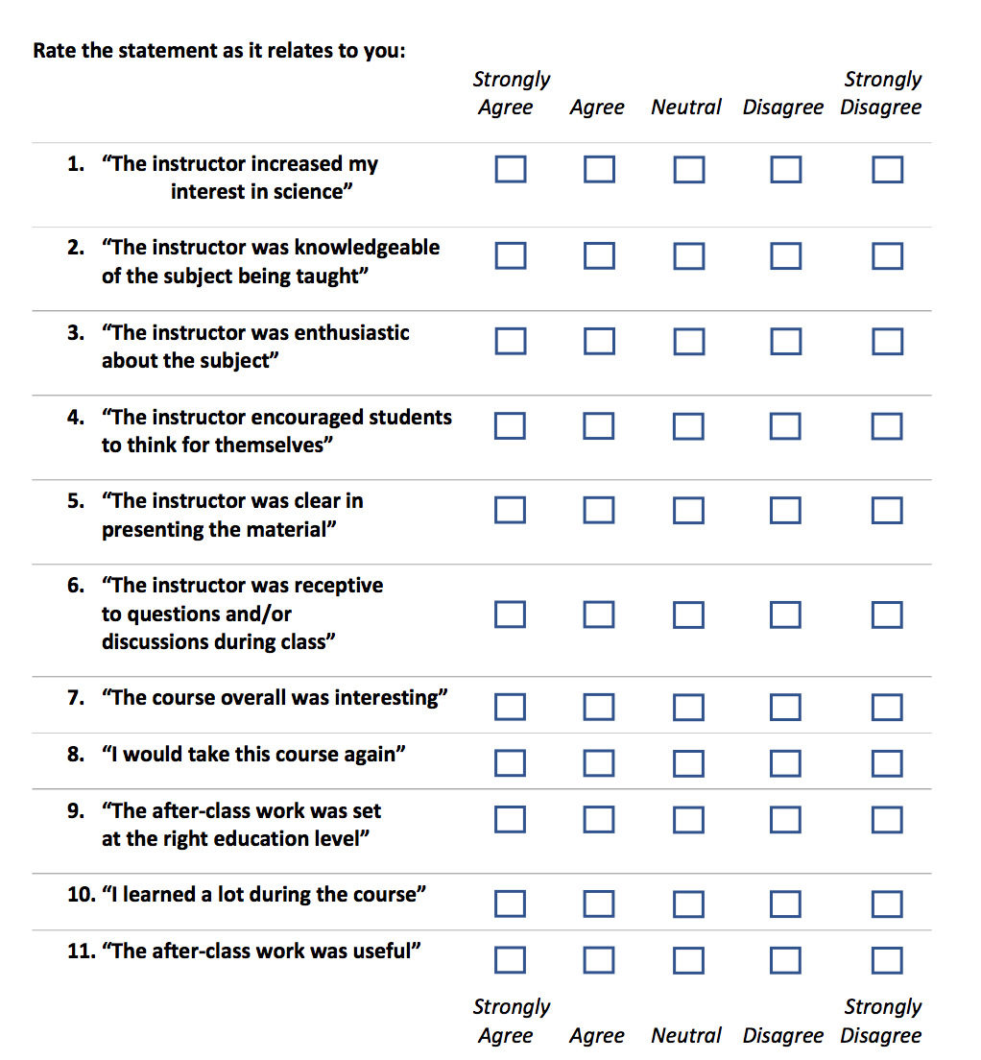

Slide 114
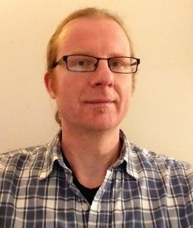
EU
Jeroen

Slide 115
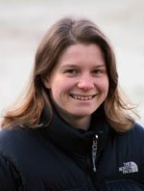
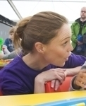
EU
Jeroen
Paula Street
Lorraine Coghill

Slide 116
EU
Jeroen
Paula Street
Cell Block Science
Lorraine Coghill
Mhairi Stewart

Slide 117
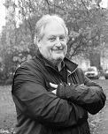
EU
Jeroen
Paula Street
Ivan Hill
Cell Block Science
Lorraine Coghill
Mhairi Stewart

Slide 118
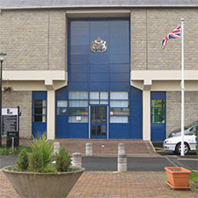
Lynda Elliott
HMP Durham
EU
Jeroen
Paula Street
Ivan Hill
Cell Block Science
Lorraine Coghill
Mhairi Stewart

Slide 119
Lynda Elliott
HMP Durham
EU
Jeroen
Paula Street
Ivan Hill
Cell Block Science
Lorraine Coghill
Inside-Out Program
Hannah King
Mhairi Stewart

Slide 120


Lynda Elliott
HMP Durham
EU
Jeroen
Paula Street
Ivan Hill
Cell Block Science
Lorraine Coghill
Kate O’Brien
Inside-Out Program
Hannah King
Lori Pompa
Mhairi Stewart

Slide 121
Lynda Elliott
HMP Durham
EU
Jeroen
Paula Street
Ivan Hill
Closing Ceremony
Cell Block Science
Lorraine Coghill
Kate O’Brien
Inside-Out Program
Hannah King
Lori Pompa
Mhairi Stewart

Slide 122

Lynda Elliott
HMP Durham
EU
Jeroen
Paula Street
Ivan Hill
Closing Ceremony
Cell Block Science
Lorraine Coghill
Kate O’Brien
Inside-Out Program
Hannah King
Lori Pompa
Mhairi Stewart

Slide 123
Lynda Elliott
HMP Durham
EU
Jeroen
Paula Street
Ivan Hill
Closing Ceremony
Cell Block Science
Lorraine Coghill
Kate O’Brien
Inside-Out Program
Hannah King
Lori Pompa
Mhairi Stewart
Think Tank
Think Tank
Closing Ceremony
HMP Low Newton
HMP Frankland

Slide 124
Lynda Elliott
HMP Durham
EU
Jeroen
Paula Street
Ivan Hill
Closing Ceremony
Cell Block Science
Lorraine Coghill
Kate O’Brien
Inside-Out Program
Hannah King
Lori Pompa
Mhairi Stewart
Think Tank
Think Tank
Closing Ceremony
Marianne Burrows
HMP Low Newton
HMP Frankland
Sarah Blackman
Cheryl Adamson

Slide 125
Lynda Elliott
HMP Durham
EU
Jeroen
Paula Street
Ivan Hill
Closing Ceremony
Cell Block Science
Lorraine Coghill
Kate O’Brien
Inside-Out Program
Hannah King
Lori Pompa
Mhairi Stewart
Think Tank
Think Tank
Closing Ceremony
Marianne Burrows
HMP Low Newton
HMP Frankland
Sarah Blackman
HMP/YOI Deerbolt
Cheryl Adamson

Slide 126

Lynda Elliott
HMP Durham
EU
Jeroen
Paula Street
Ivan Hill
Closing Ceremony
Cell Block Science
Lorraine Coghill
Anna Fellingham
Jacky Woods
Kate O’Brien
Inside-Out Program
Hannah King
Lori Pompa
Mhairi Stewart
Think Tank
Think Tank
Closing Ceremony
Marianne Burrows
HMP Low Newton
HMP Frankland
Sarah Blackman
HMP/YOI Deerbolt
Cheryl Adamson

Slide 127


Lynda Elliott
HMP Durham
EU
Jeroen
Paula Street
Ivan Hill
Closing Ceremony
Andy Aplin
Cell Block Science
Lorraine Coghill
Anna Fellingham
Jacky Woods
Kate O’Brien
Inside-Out Program
Hannah King
Lori Pompa
Tony Key
Mhairi Stewart
Think Tank
Think Tank
Closing Ceremony
Marianne Burrows
HMP Low Newton
HMP Frankland
Sarah Blackman
Bill Bryson
HMP/YOI Deerbolt
Cheryl Adamson

Slide 128
Lynda Elliott
HMP Durham
EU
Jeroen
Paula Street
Ivan Hill
Closing Ceremony
Andy Aplin
Cell Block Science
Danielle George
Lorraine Coghill
Anna Fellingham
Jacky Woods
Kate O’Brien
Inside-Out Program
Hannah King
Lori Pompa
Tony Key
Mhairi Stewart
Think Tank
Think Tank
Closing Ceremony
Marianne Burrows
HMP Low Newton
HMP Frankland
Sarah Blackman
Bill Bryson
HMP/YOI Deerbolt
Cheryl Adamson

Slide 129
Why?
Desperate state of the UK prison system
Education cut backs
Numerical modelling of plate tectonics
Useful
Ability to teach anything to anyone

Slide 130

Why?
“Aside from UDUR, the local prison is the major entity in the city. It is a desire of the applicant to also start a science outreach program at Durham prison33, of which geophysics will be the opening workshop. The ER will work with the outreach team at UDUR to start a program that would begin towards the end of the fellowship (DP), but with monthly meetings occurring on the logistical setup throughout the fellowship. It would not only be an excellent teaching experience but broaden the applicant’s education skills to be able to communicate to such a unique audience, and will lead to more interesting opportunities for outreach in the future.”

Slide 131
Why?
“Aside from UDUR, the local prison is the major entity in the city. It is a desire of the applicant to also start a science outreach program at Durham prison33, of which geophysics will be the opening workshop. The ER will work with the outreach team at UDUR to start a program that would begin towards the end of the fellowship (DP), but with monthly meetings occurring on the logistical setup throughout the fellowship. It would not only be an excellent teaching experience but broaden the applicant’s education skills to be able to communicate to such a unique audience, and will lead to more interesting opportunities for outreach in the future.”

Slide 132
Why?

Slide 133
Outline
The course
Why
How
Input from inmates
Overall theme - TLAS
First week - icebreaker
Planning classes
What a class was like – example
Guest Speaker
Homework
Experiment
Presentation
What I learned – feedback / pathways to learning / getting science to people who haven’t got that /
Future plans
Could we be doing more?

Slide 134
How
Prison
Paula Street
Ivan Hill
EU
Closing Ceremony
Lynda
Jeroen
HMP Durham
Inside-Out Program
Cell Block Science
Danielle George
Tony Key
Mhairi Stewart
Hannah King
Think Tank
Bill Bryson
HMP Frankland
HMP Low Newton
Closing Ceremony
Think Tank
Marianne Burrows
Sarah Blackman
Cheryl Adamson
HMP/YOI Deerbolt

Slide 135
Why?
SOAPBOX pictures of Durham.
Local ness
Useful

Slide 136
Previous courses
CELL BLOCK SCIENCE
Dr Hannah King
Dr Mhairi Stewart

Slide 137
Input from inmates & others
Dr Hannah King
Dr Kate O’Brien

Slide 138
How?

Slide 139
Marie Sklodowska Curie Fellow

Slide 140
Lynda Elliott
HMP Durham
EU
Jeroen
Paula Street
Ivan Hill
Closing Ceremony
Andy Aplin
Cell Block Science
Danielle George
Lorraine Coghill
Anna Fellingham
Jacky Woods
Kate O’Brien
Inside-Out Program
Hannah King
Lori Pompa
Tony Key
Mhairi Stewart
Think Tank
Think Tank
Closing Ceremony
Marianne Burrows
HMP Low Newton
HMP Frankland
Sarah Blackman
Bill Bryson
HMP/YOI Deerbolt
Cheryl Adamson

Slide 141
Lynda Elliott
HMP Durham
EU
Jeroen
Paula Street
Ivan Hill
Closing Ceremony
Andy Aplin
Cell Block Science
Danielle George
Lorraine Coghill
Anna Fellingham
Jacky Woods
Kate O’Brien
Inside-Out Program
Hannah King
Lori Pompa
Tony Key
Mhairi Stewart
Think Tank
Think Tank
Closing Ceremony
Marianne Burrows
HMP Low Newton
HMP Frankland
Sarah Blackman
Bill Bryson
HMP/YOI Deerbolt
Cheryl Adamson

Slide 142

What does a scientist do?
Scientists try to find the truth, piece by piece, of how things work.
It is often through really small discoveries that eventually lead to a breakthrough.
Research is a lot like walking into a dark room, and trying to discover what type of room it is.
A scientist asks a lot of questions, and is prepared to fail in the pursuit of discovery.
LN2019 Think Like A Scientist W1

Slide 143
What does a scientist do?
Scientists try to find the truth, piece by piece, of how things work.
It is often through really small discoveries that eventually lead to a breakthrough.
Research is a lot like walking into a dark room, and trying to discover what type of room it is.
A scientist asks a lot of questions, and is prepared to fail in the pursuit of discovery.
LN2019 Think Like A Scientist W1

Slide 144
What does a scientist do?
Scientists try to find the truth, piece by piece, of how things work.
It is often through really small discoveries that eventually lead to a breakthrough.
Research is a lot like walking into a dark room, and trying to discover what type of room it is.
A scientist asks a lot of questions, and is prepared to fail in the pursuit of discovery.
LN2019 Think Like A Scientist W1

Slide 145
Feedback

Slide 146
What does a scientist do?
Scientists try to find the truth, piece by piece, of how things work.
It is often through really small discoveries that eventually lead to a breakthrough.
Research is a lot like walking into a dark room, and trying to discover what type of room it is.
A scientist asks a lot of questions, and is prepared to fail in the pursuit of discovery.
LN2019 Think Like A Scientist W1

Slide 147
How?

Slide 148
How?

Slide 149
How?

Slide 150
Lynda Elliott
HMP Durham
EU
Jeroen
Paula Street
Ivan Hill
Closing Ceremony
Andy Aplin
Cell Block Science
Danielle George
Lorraine Coghill
Anna Fellingham
Jacky Woods
Kate O’Brien
Inside-Out Program
Hannah King
Lori Pompa
Tony Key
Mhairi Stewart
Think Tank
Think Tank
Closing Ceremony
Marianne Burrows
HMP Low Newton
HMP Frankland
Sarah Blackman
Bill Bryson
HMP/YOI Deerbolt
Cheryl Adamson

Slide 151
Think Like A Scientist
Presently, being a scientist is a lot more than testing a theory – you are required to be able to understand how good your findings are through data analysis, and also be able to communicate your work in a clear and concise manner.
The Think Like A Scientist course teaches the students how to use the scientific method alongside applying analytical and communication skills.
Each class will last around 2 hours and have the same basic framework:
- introduction to the main science topic
- activities surrounding the main topic
- assignment of main topic reading to be summarized and analysed
- a section on improving communication
LN2019 Think Like A Scientist W1

Slide 152
Think Like A Scientist
Presently, being a scientist is a lot more than testing a theory – you are required to be able to understand how good your findings are through data analysis, and also be able to communicate your work in a clear and concise manner.
The Think Like A Scientist course teaches the students how to use the scientific method alongside applying analytical and communication skills.
Each class will last around 2 hours and have the same basic framework:
- introduction to the main science topic
- activities surrounding the main topic
- assignment of main topic reading to be summarized and analysed
- a section on improving communication
LN2019 Think Like A Scientist W1

